Slide 1

BANGLADESH UNIVERSITY OF ENGINEERING AND TECHNOLOGY
NAME 338
SHIP DESIGN PROJECT AND PRESENTATION
Under the supervision of:
Dr. Md. Mashiur Rahaman
Professor
Department of Naval Architecture and Marine Engineering
BUET
Prepared by,
Noshin Tarannum Tasfia (1712002)
Rafid Imam (1712043)

Slide 2
TABLE OF CONTENTS
Page
Page
Owner’s Requirement | 03
Route Specification | 04
Basis Ship Selection | 05
Principal Particulars Comparison between Basis Ship and Design Ship | 06
Principal Particulars Comparison between Preliminary and Final Design Ship | 07
Manning | 08
General Arrangement Plan | 09
Lines Plan | 10
Final Offset Table for Design Ship | 11
Hydrostatics Curves | 12
Scantling Calculation | 13
Midship Section | 16
Longitudinal Construction | 17
Resistance Calculation | 23
Power Calculation | 24
Engine and Gear Box Selection | 26
Lacking From Third Presentation | 28
Achievements | 29
Rudder Calculation Summary | 30
Rudder Design | 31
Steering Gear Arrangement | 33
Propeller Design | 35
Propeller Cavitation Check | 36
Propeller Shaft Arrangement | 37
Engine Foundation Summary | 38
Design on Engine Foundation | 39
Trim Calculation | 41
Stability Calculation | 42
Shell Expansion | 18
Detailed Lightweight and Deadweight Calculation | 20

Slide 3
OWNER’S REQUIREMENT
Vessel Type: General Cargo
Route: Dhaka to Chittagong
Service Speed: 10 knot
Deadweight: 3000 tones

Slide 4
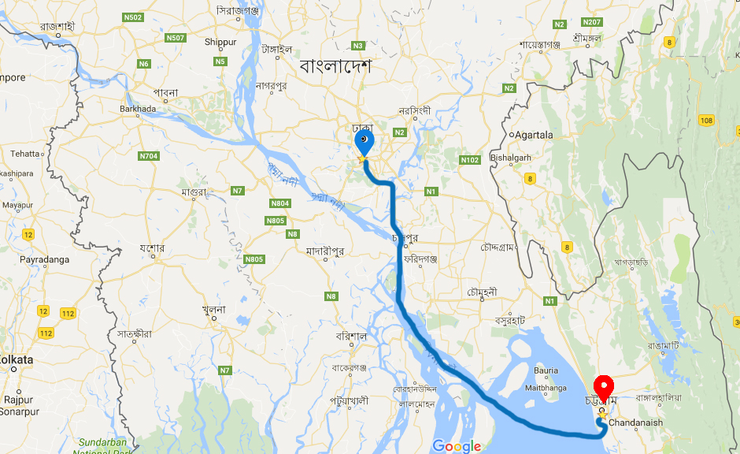
ROUTE SPECIFICATION
Route: Dhaka to Chittagong
(Shadar Ghat to Chittagong Port)
Route Length: 304 km
(164 Nautical Miles)

Slide 5
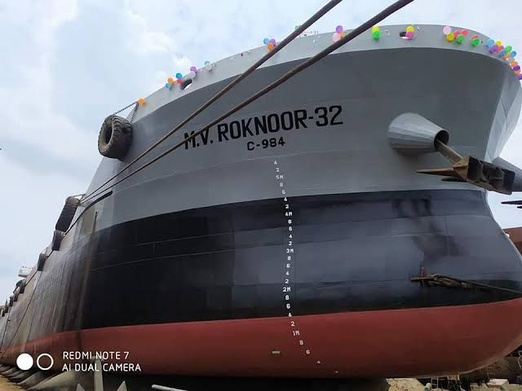
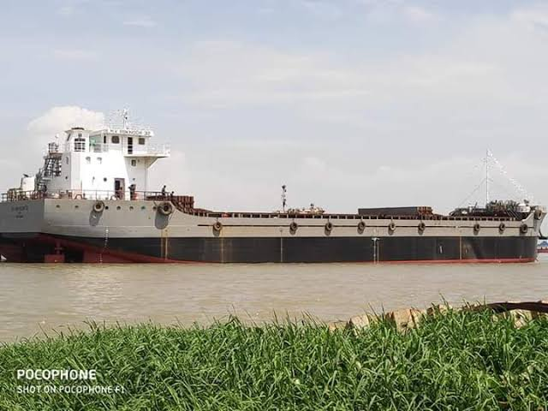
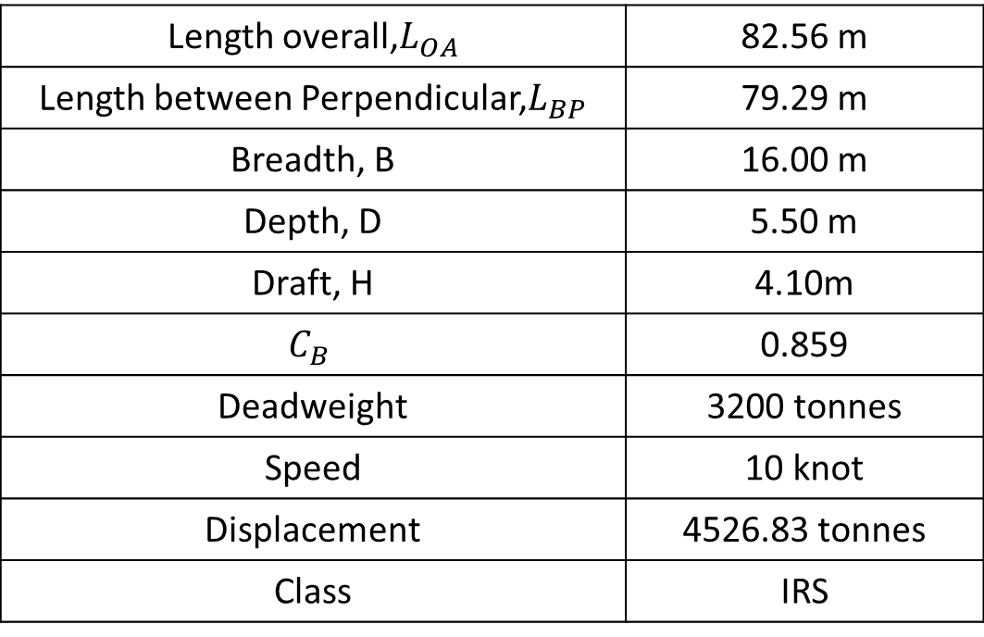
BASIS SHIP SELECTION
M.V. ROKNOOR 32
Length overall,$L_{OA}$ | 82.56 m
Length between Perpendicular,$L_{BP}$ | 79.29 m
Breadth, B | 16.00 m
Depth, D | 5.50 m
Draft, H | 4.10m
$$C_{B}$$ | 0.859
Deadweight | 3200 tonnes
Speed | 10 knot
Displacement | 4526.83 tonnes
Class | IRS
Source: https://www.omeltd.com/projects/15

Slide 6
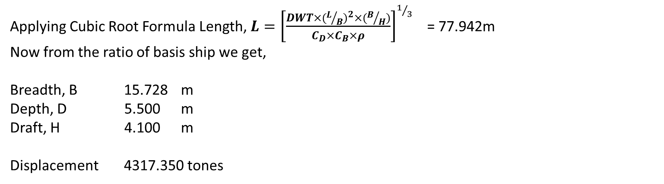
DETERMINATION OF PRINCIPAL PARTICULARS OF DESIGN SHIP
From the Ratio of Basis Ship:
L/B = 4.956
B/H = 3.902
B/D = 2.909
H/B = 0.256
Applying Cubic Root Formula Length, ${L=\left[\frac{DWT×(L/B)^{2}×(B/H)}{C_{D}×C_{B}×ρ}\right]}^{1/3}$ = 77.942m
Now from the ratio of basis ship we get,
Breadth, B 15.728 m
Depth, D 5.500 m
Draft, H 4.100 m
Displacement 4317.350 tones

Slide 7
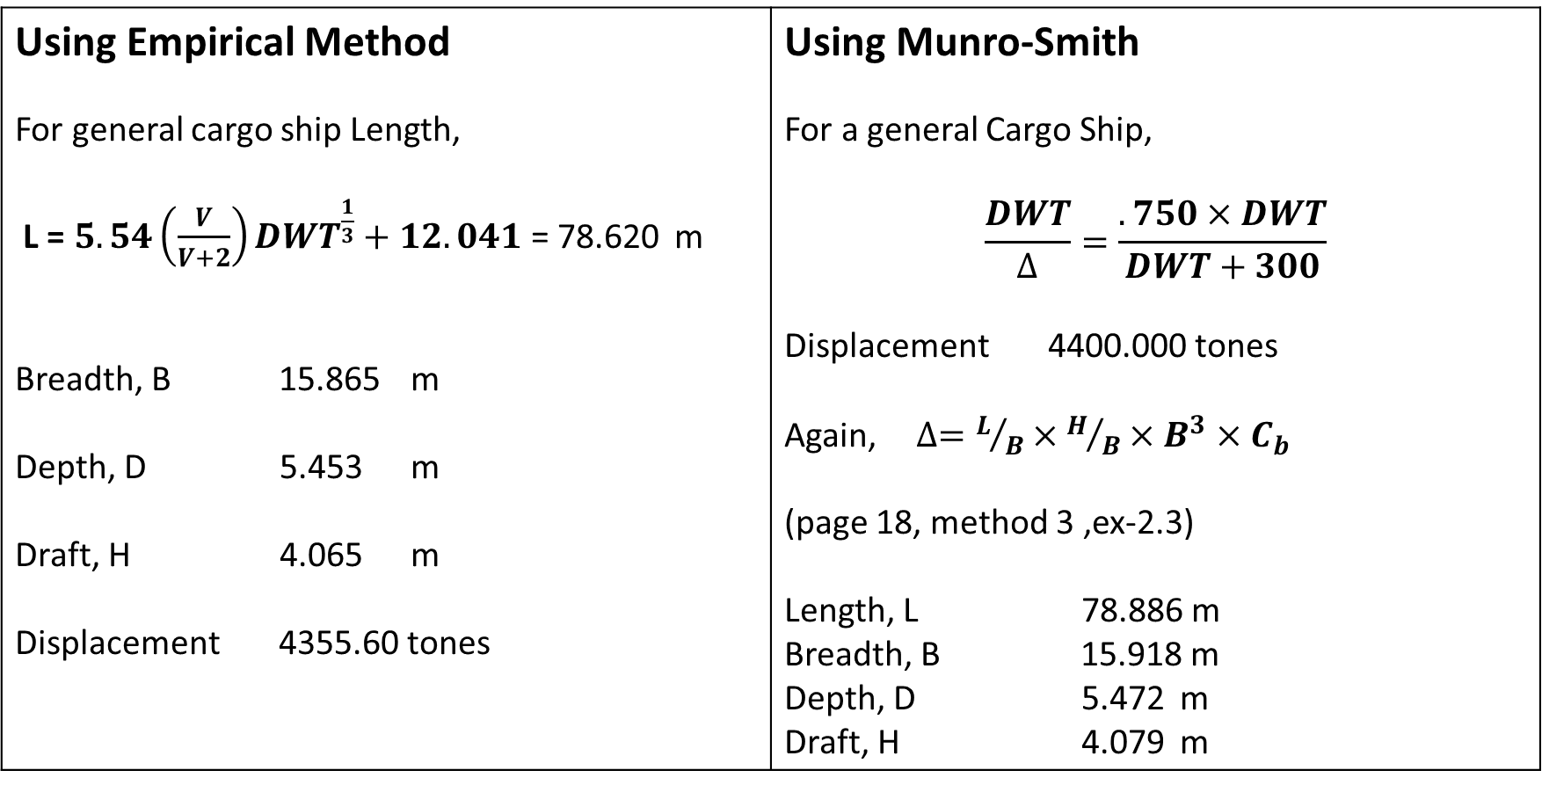
DETERMINATION OF PRINCIPAL PARTICULARS OF DESIGN SHIP
Using Empirical Method For general cargo ship Length, L = $5.54\left(\frac{V}{V+2}\right)DWT^{\frac{1}{3}}+12.041$ = 78.620 m Breadth, B 15.865 m Depth, D 5.453 m Draft, H 4.065 m Displacement 4355.60 tones | Using Munro-Smith For a general Cargo Ship, $$\frac{DWT}{∆}=\frac{.750×DWT}{DWT+300}$$ Displacement 4400.000 tones Again, $∆=L/B×H/B×B^{3}×C_{b}$ (page 18, method 3 ,ex-2.3) Length, L 78.886 m Breadth, B 15.918 m Depth, D 5.472 m Draft, H 4.079 m

Slide 8
DETERMINATION OF PRINCIPAL PARTICULARS OF DESIGN SHIP
Comparison among different methods
 | Using Basis Ship Ratio | Using Empirical Formula | Using formula from Munro Smith | Average dimensions
Length, L | 77.942 | 78.620 | 78.886 | 78.483
Breadth, B | 15.728 | 15.865 | 15.918 | 15.837
Depth, D | 5.500 | 5.453 | 5.472 | 5.475
Draft, H | 4.100 | 4.065 | 4.079 | 4.081

Slide 9
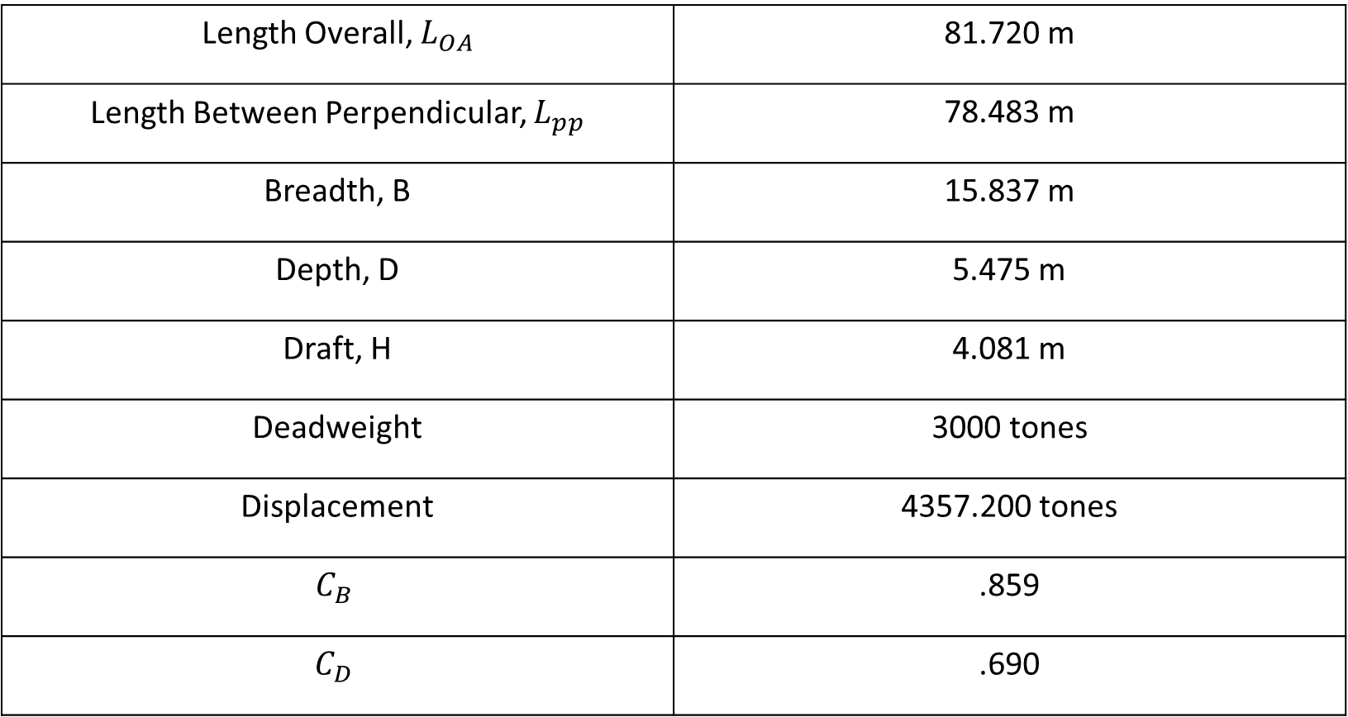
Principal Particulars of Design Ship
Length Overall, $L_{OA}$ | 81.720 m
Length Between Perpendicular, $L_{pp}$ | 78.483 m
Breadth, B | 15.837 m
Depth, D | 5.475 m
Draft, H | 4.081 m
Deadweight | 3000 tones
Displacement | 4357.200 tones
$$C_{B}$$ | .859
$$C_{D}$$ | .690

Slide 10
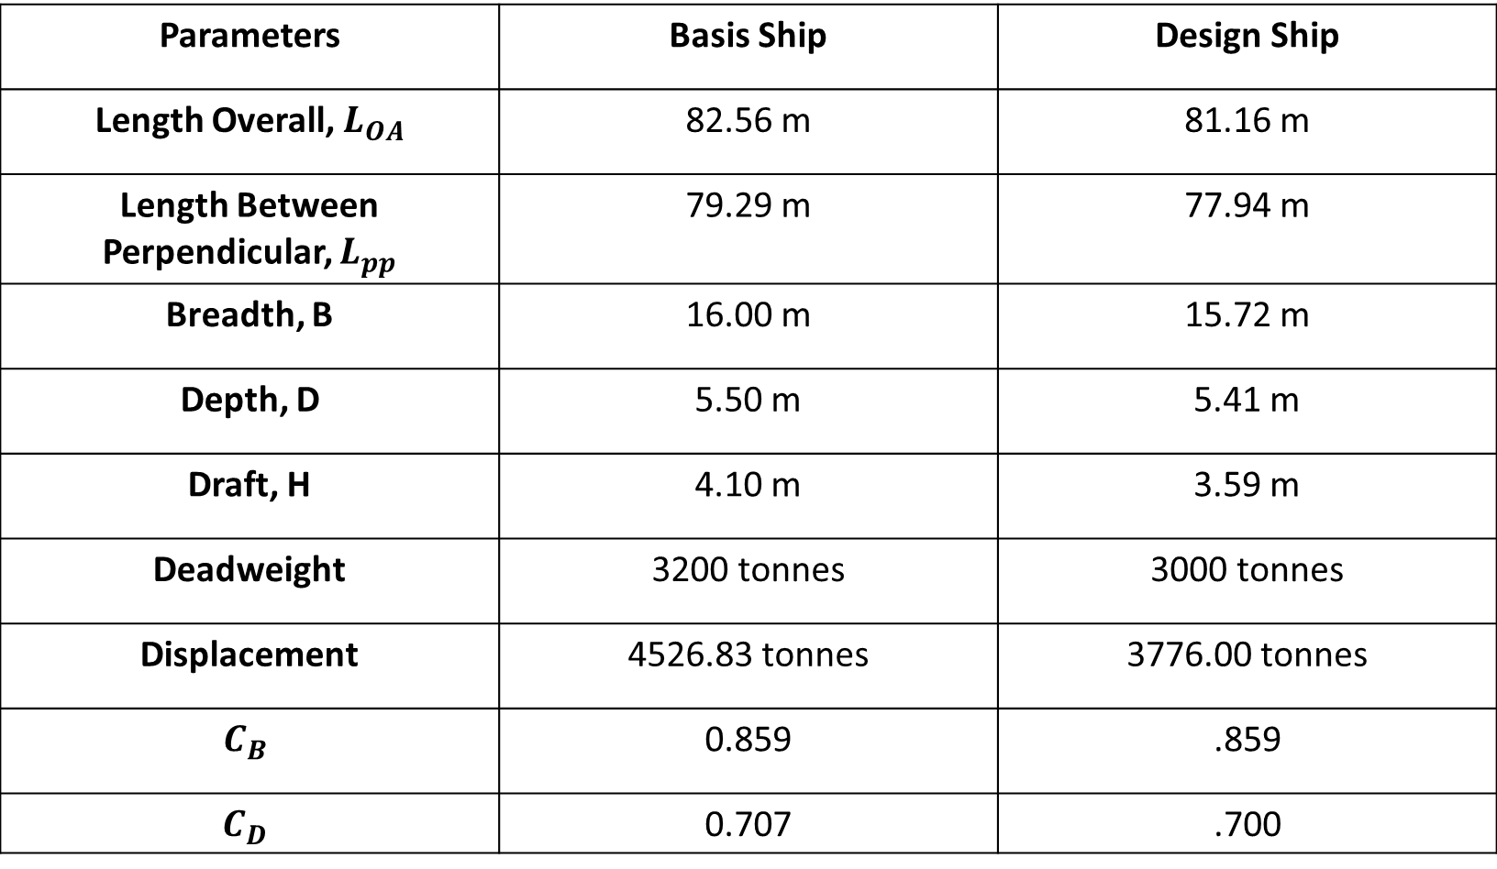
PRINCIPAL PARTICULARS COMPARISON BETWEEN BASIS SHIP AND DESIGN SHIP
Parameters | Basis Ship | Design Ship
Length Overall, $L_{OA}$ | 82.56 m | 81.16 m
Length Between Perpendicular, $L_{pp}$ | 79.29 m | 77.94 m
Breadth, B | 16.00 m | 15.72 m
Depth, D | 5.50 m | 5.41 m
Draft, H | 4.10 m | 3.59 m
Deadweight | 3200 tonnes | 3000 tonnes
Displacement | 4526.83 tonnes | 3776.00 tonnes
$$C_{B}$$ | 0.859 | .859
$$C_{D}$$ | 0.707 | .700

Slide 11
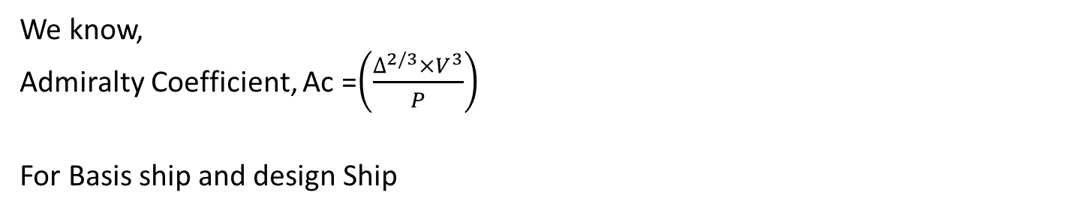
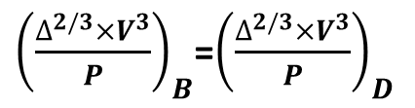
POWER ESTIMATION & MANNING
We know,
Admiralty Coefficient, Ac =${\left(\frac{∆^{2/3}×V^{3}}{P}\right)}_{}$
For Basis ship and design Ship
${\left(\frac{∆^{2/3}×V^{3}}{P}\right)}_{B}$=${\left(\frac{∆^{2/3}×V^{3}}{P}\right)}_{D}$
Power of Basis Ship 1125 KW
So using the formula we can estimate the power of Design Ship = 1096 KW
1096 KW for two Engines. Thus 548 KW for each of them
Fuel Used : Diesel

Slide 12
PRELIMINARY WEIGHT CALCULATION AND POWER ESTIMATION
Service Speed , V = 10 knot
= 18.5 km/h
Voyage distance , s = 164 nautical miles
Voyage time, t = 2 ∙ s / v =32.800 Hours
= 1.3667 Days
Endurance time = 4Days
= 96 Hours
Cargo Capacity (tones) = 2950 tones
Engine Information
Model M26
BHP 548 KW each
SFC ≤ 213 gKW/h
SLOC ≤ 1.0 gKW/h
Source : Weichai Marine Engines
Power of Basis Ship = 1125 KW
Admiralty Coefficient of Basis Ship : 243.2150866
Crew Member: 16

Slide 13
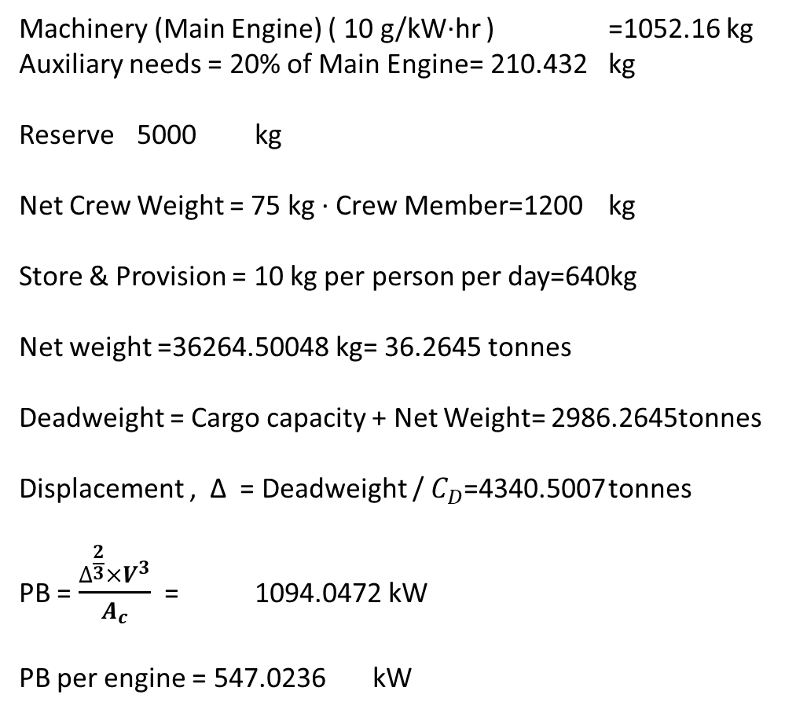
PRELIMINARY WEIGHT CALCULATION AND POWER ESTIMATION
Iteration 1
BHP ( Single Engine ) 548 kW
BHP = ( 2 ∙ 1 engine's BHP ) 1096 kW
SFC ( Single Engine ) 213 g/kW∙hr
SLOC ( Single Engine ) 0.8 g/kW∙hr
Constant Addition of Fuel 1.5 1.14-1.5
WHFO = SFC ∙ BHP ∙ Voyage time ∙ Constant Addition =11485.6416 kg
WDO = 20% of WHFO = 2297.12832 kg
WLO = SLOC ∙ BHP ∙ Voyage time ∙ Constant Addition =43.13856 kg
Fresh water consumption for
Crew = 20 kg per person per day=1280 kg
Bath & Laundry needs = 200 kg per person per day
=12800 kg
Cooking = 4 kg per person per day 256 kg
Machinery (Main Engine) ( 10 g/kW∙hr ) =1052.16 kg
Auxiliary needs = 20% of Main Engine= 210.432 kg
Reserve 5000 kg
Net Crew Weight = 75 kg ∙ Crew Member=1200 kg
Store & Provision = 10 kg per person per day=640kg
Net weight =36264.50048 kg= 36.2645 tonnes
Deadweight = Cargo capacity + Net Weight= 2986.2645tonnes
Displacement , Δ = Deadweight / $C_{D}$=4340.5007 tonnes
PB = $\frac{∆^{\frac{2}{3}}×V^{3}}{A_{c}}$ = 1094.0472 kW
PB per engine = 547.0236 kW

Slide 14
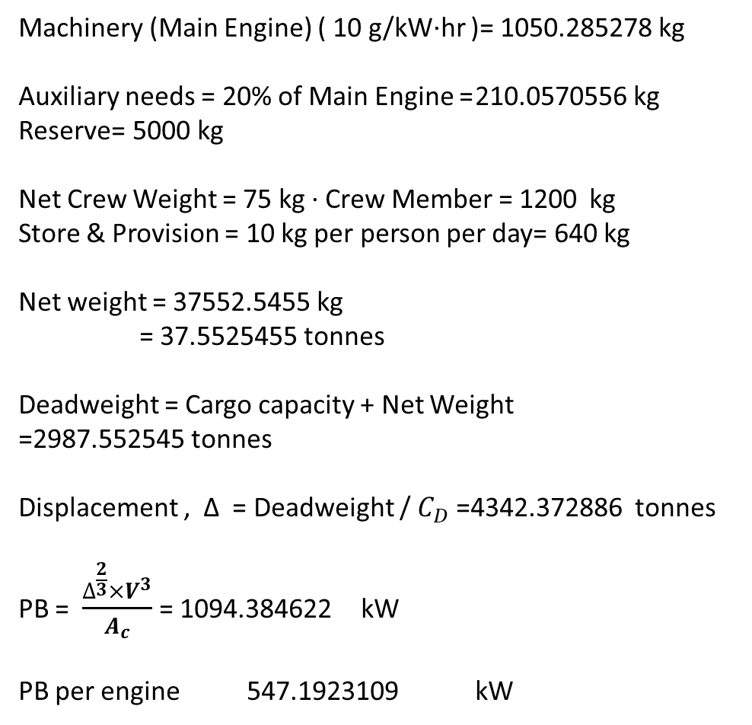
PRELIMINARY WEIGHT CALCULATION AND POWER ESTIMATION
Iteration 2
BHP ( Single Engine ) 547.0236 kW
BHP = ( 2 ∙ 1 engine's BHP ) 1094.047165 kW
SFC ( Single Engine ) 211 g/kW∙hr
SLOC ( Single Engine ) 0.8 g/kW∙hr
Constant Addition of Fuel 1.5 1.14-1.5
WHFO = SFC ∙ BHP ∙ Voyage time ∙ Constant Addition =12557.1609 kg
WDO = 20% of WHFO= 2511.43218 kg
WLO = SLOC ∙ BHP ∙ Voyage time ∙ Constant Addition =47.61008871 kg
Fresh water consumption for Crew = 20 kg per person per day = 1280kg
Bath & Laundry needs = 200 kg per person per day =12800 kg
Cooking = 4 kg per person per day 256 kg
Machinery (Main Engine) ( 10 g/kW∙hr )= 1050.285278 kg
Auxiliary needs = 20% of Main Engine = 210.0570556 kg
Reserve= 5000 kg
Net Crew Weight = 75 kg ∙ Crew Member = 1200 kg
Store & Provision = 10 kg per person per day= 640 kg
Net weight = 37552.5455 kg
= 37.5525455 tonnes
Deadweight = Cargo capacity + Net Weight =2987.552545 tonnes
Displacement , Δ = Deadweight / $C_{D}$ =4342.372886 tonnes
PB = $\frac{∆^{\frac{2}{3}}×V^{3}}{A_{c}}$ = 1094.384622 kW
PB per engine 547.1923109 kW

Slide 15
PRELIMINARY WEIGHT CALCULATION AND POWER ESTIMATION
Following the same path as before we got,
Iteration 3 | 546.969 KW
Iteration 4 | 546.968 KW
Iteration 5 | 546.968 KW
Preliminary Engine Power 547 KW each
Total of 1094 KW
Source: Ship Design Methodologies of Preliminary Design by Apostolos Papanikolaou

Slide 16
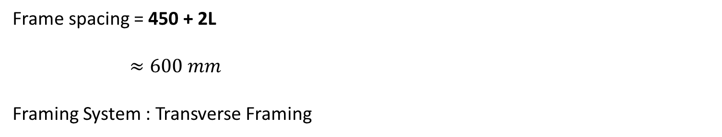
PRELIMINARY GENERAL ARRANGEMENT PLAN
Determination of Number of Bulkheads
Distance between two bulkheads = .15L + 6.5
=18.27 m
So the Number of Bulkhead Stands = 4
Determination of Frame Spacing
Frame spacing = 450 + 2L
$≈600 mm$
Framing System : Transverse Framing
Source: Inland Shipping Ordinance

Slide 17
MANNING
Owner | 1
1st Class Master | 1
2nd Class Master | 1
Sailor | 7
Inland Marine Engineer | 2
1st Class Driver | 1
Greaser | 3
Total | 16
Speed 10 knots
Source: Inland Shipping Ordinance

Slide 18
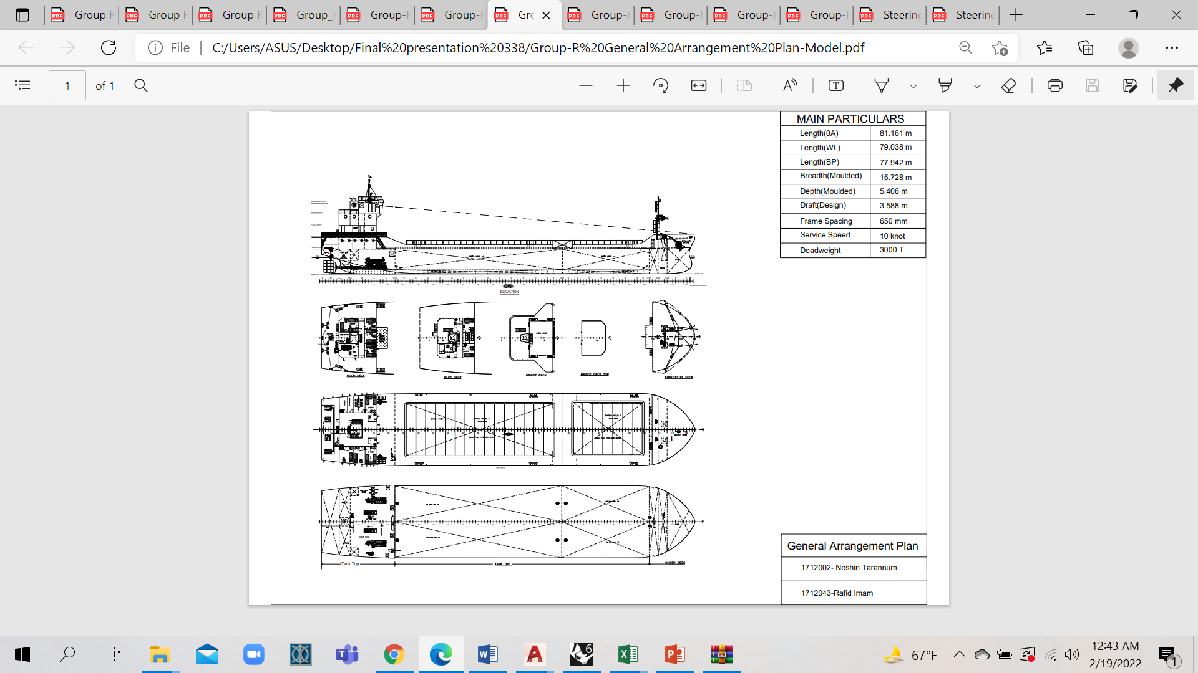
GENERAL ARRANGEMENT PLAN

Slide 19
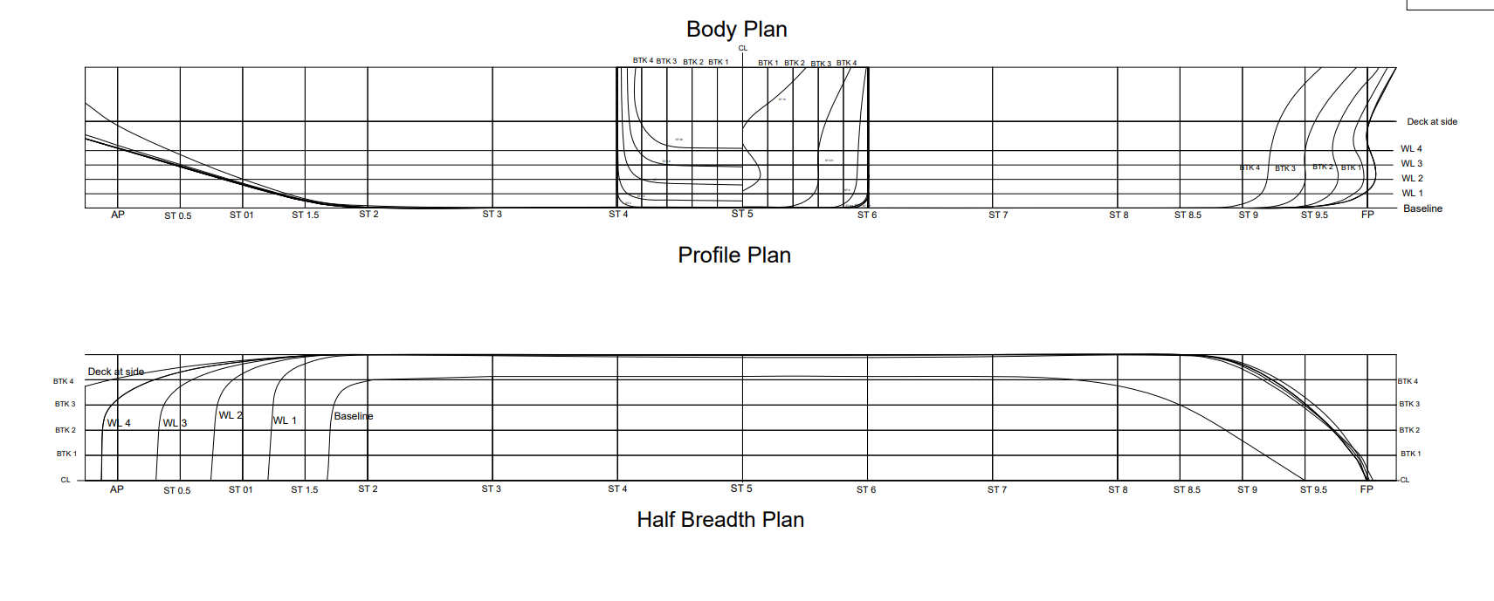
LINES PLAN

Slide 20
FINAL OFFSET TABLE FOR DESIGN SHIP

Slide 21
Calculation for Waterline 01
Water Plane area, Displacement, LCB, VCB calculation for WL - 1
Water planes |  | 0 |  | 1 |  | 2 |  | Section Distance | 7.79 | WP Distance |  | 0.90
 | SM | 5 |  | 8 |  | -1 |  | Area products for sectional area | Sectional area below waterline | Volume Function | Levers | Moments about amidship
Section | SM | y₀ | y x SM | y₁ | y x SM | y₂ | y x SM
0.00 | 0.50 | 0.00 | 0.00 | 0.00 | 0.00 | 0.00 | 0.00 | 0.00 | 0.00 | 0.00 | -5.00 | 0.00
0.50 | 2.00 | 0.00 | 0.00 | 0.00 | 0.00 | 0.00 | 0.00 | 0.00 | 0.00 | 0.00 | -4.50 | 0.00
1.00 | 1.00 | 0.00 | 0.00 | 0.00 | 0.00 | 6.26 | 6.26 | -6.26 | -0.94 | -0.94 | -4.00 | 3.75
1.50 | 2.00 | 0.00 | 0.00 | 7.16 | 14.33 | 7.68 | 15.35 | 49.63 | 7.42 | 14.84 | -3.50 | -51.94
2.00 | 1.50 | 6.21 | 9.31 | 7.79 | 11.68 | 7.85 | 11.78 | 85.49 | 12.78 | 19.17 | -3.00 | -57.51
3.00 | 4.00 | 6.50 | 26.00 | 7.85 | 31.39 | 7.86 | 31.46 | 87.42 | 13.07 | 52.27 | -2.00 | -104.55
4.00 | 2.00 | 6.50 | 13.00 | 7.85 | 15.70 | 7.86 | 15.73 | 87.42 | 13.07 | 26.14 | -1.00 | -26.14
5.00 | 4.00 | 6.50 | 26.00 | 7.85 | 31.39 | 7.86 | 31.46 | 87.42 | 13.07 | 52.27 | 0.00 | 0.00
6.00 | 2.00 | 6.50 | 13.00 | 7.85 | 15.70 | 7.86 | 15.73 | 87.42 | 13.07 | 26.14 | 1.00 | 26.14
7.00 | 4.00 | 6.50 | 26.00 | 7.85 | 31.39 | 7.86 | 31.46 | 87.42 | 13.07 | 52.27 | 2.00 | 104.55
8.00 | 1.50 | 5.92 | 8.88 | 7.84 | 11.76 | 7.86 | 11.80 | 84.48 | 12.63 | 18.94 | 3.00 | 56.83
8.50 | 2.00 | 4.72 | 9.44 | 7.79 | 15.57 | 7.84 | 15.69 | 78.05 | 11.67 | 23.34 | 3.50 | 81.68
9.00 | 1.00 | 2.50 | 2.50 | 6.90 | 6.90 | 7.12 | 7.12 | 60.62 | 9.06 | 9.06 | 4.00 | 36.25
9.50 | 2.00 | 2.48 | 4.96 | 4.44 | 8.88 | 4.73 | 9.47 | 43.19 | 6.46 | 12.91 | 4.50 | 58.11
10.00 | 0.50 | 0.00 | 0.00 | 0.00 | 0.00 | 1.02 | 0.51 | -1.02 | -0.15 | -0.08 | 5.00 | -0.38
Different totals |  | Sum of the area products of WP 0 | 139.09 | Sum of the area products of WP 1 | 194.69 | Sum of the area products of WP 2 | 203.79 | Summation of volume functions |  | 306.35 | Summation of moments | 126.79
Waterplane area |  | 722.75 |  | 1011.66 |  | 1058.94
SM |  | 5.00 |  | 8.00 |  | -1.00 |  | VOLUME |  | 795.920 | LCB | 3.23
Volume products |  | 3613.74 |  | 8093.26 |  | -1058.94 |  | Summation of volume products | 10648.06 | VOLUME |  | 795.92
Levers |  | 0.00 |  | 1.00 |  | 2.00
Monent about the keel |  | 0.00 |  | 8093.26 |  | -2117.89 |  | Summation of moments | 5975.38 | VCB |  | 0.50

Slide 22
Calculation for Waterline 02
Water Plane area, Displacement, LCB, VCB calculation for WL - 2
Water planes |  | 0 |  | 1 |  | 2 |  | Section Distance | 7.79 | WP Distance |  | 0.90
 | SM | 1 |  | 4 |  | 1 |  | Area products for sectional area | Sectional area below waterline | Volume Function | Levers | Moments about amidship
Section | SM | y₀ | y x SM | y₁ | y x SM | y₂ | y x SM
0.00 | 0.50 | 0.00 | 0.00 | 0.00 | 0.00 | 0.00 | 0.00 | 0.00 | 0.00 | 0.00 | -5.00 | 0.00
0.50 | 2.00 | 0.00 | 0.00 | 0.00 | 0.00 | 0.00 | 0.00 | 0.00 | 0.00 | 0.00 | -4.50 | 0.00
1.00 | 1.00 | 0.00 | 0.00 | 0.00 | 0.00 | 6.26 | 6.26 | 6.26 | 3.75 | 3.75 | -4.00 | -14.98
1.50 | 2.00 | 0.00 | 0.00 | 7.16 | 14.33 | 7.68 | 15.35 | 36.33 | 21.72 | 43.45 | -3.50 | -152.07
2.00 | 1.50 | 6.21 | 9.31 | 7.79 | 11.68 | 7.85 | 11.78 | 45.21 | 27.03 | 40.55 | -3.00 | -121.65
3.00 | 4.00 | 6.50 | 26.00 | 7.85 | 31.39 | 7.86 | 31.46 | 45.75 | 27.36 | 109.44 | -2.00 | -218.88
4.00 | 2.00 | 6.50 | 13.00 | 7.85 | 15.70 | 7.86 | 15.73 | 45.75 | 27.36 | 54.72 | -1.00 | -54.72
5.00 | 4.00 | 6.50 | 26.00 | 7.85 | 31.39 | 7.86 | 31.46 | 45.75 | 27.36 | 109.44 | 0.00 | 0.00
6.00 | 2.00 | 6.50 | 13.00 | 7.85 | 15.70 | 7.86 | 15.73 | 45.75 | 27.36 | 54.72 | 1.00 | 54.72
7.00 | 4.00 | 6.50 | 26.00 | 7.85 | 31.39 | 7.86 | 31.46 | 45.75 | 27.36 | 109.44 | 2.00 | 218.88
8.00 | 1.50 | 5.92 | 8.88 | 7.84 | 11.76 | 7.86 | 11.80 | 45.16 | 27.00 | 40.50 | 3.00 | 121.51
8.50 | 2.00 | 4.72 | 9.44 | 7.79 | 15.57 | 7.84 | 15.69 | 43.71 | 26.14 | 52.28 | 3.50 | 182.98
9.00 | 1.00 | 2.50 | 2.50 | 6.90 | 6.90 | 7.12 | 7.12 | 37.23 | 22.27 | 22.27 | 4.00 | 89.06
9.50 | 2.00 | 2.48 | 4.96 | 4.44 | 8.88 | 4.73 | 9.47 | 24.97 | 14.93 | 29.87 | 4.50 | 134.41
10.00 | 0.50 | 0.00 | 0.00 | 0.00 | 0.00 | 1.02 | 0.51 | 1.02 | 0.61 | 0.31 | 5.00 | 1.53
Different totals |  | Sum of the area products of WP 0 | 139.09 | Sum of the area products of WP 1 | 194.69 | Sum of the area products of WP 2 | 203.79 | Summation of volume functions |  | 670.74 | Summation of moments | 240.79
Waterplane area |  | 722.75 |  | 1011.66 |  | 1058.94
SM |  | 1.00 |  | 4.00 |  | 1.00 |  | VOLUME |  | 1742.62 | LCB | 2.80
Volume products |  | 722.75 |  | 4046.63 |  | 1058.94 |  | Summation of volume products | 5828.32 | VOLUME |  | 1742.62
Levers |  | 0.00 |  | 1.00 |  | 2.00
Monent about the keel |  | 0.00 |  | 4046.63 |  | 2117.89 |  | Summation of moments | 6164.52 | VCB |  | 0.95

Slide 23
Calculation for Waterline 03
Water Plane area, Displacement, LCB, VCB calculation for WL - 3
Water planes |  | 0 |  | 1 |  | 2 |  | 3 |  | Section Distance | 7.79 | WP Distance |  | 0.90
 | SM | 1 |  | 3 |  | 3 |  | 1 |  | Area products for sectional area | Sectional area below waterline | Volume Function | Levers | Moments about amidship
Section | SM | y₀ | y x SM | y₁ | y x SM | y₂ | y x SM | y₃ | y x SM
0.00 | 0.50 | 0.00 | 0.00 | 0.00 | 0.00 | 0.00 | 0.00 | 0.00 | 0.00 | 0.00 | 0.00 | 0.00 | -5.00 | 0.00
0.50 | 2.00 | 0.00 | 0.00 | 0.00 | 0.00 | 0.00 | 0.00 | 4.72 | 9.44 | 4.72 | 3.17 | 6.35 | -4.50 | -28.56
1.00 | 1.00 | 0.00 | 0.00 | 0.00 | 0.00 | 6.26 | 6.26 | 7.17 | 7.17 | 25.96 | 17.46 | 17.46 | -4.00 | -69.84
1.50 | 2.00 | 0.00 | 0.00 | 7.16 | 14.33 | 7.68 | 15.35 | 7.76 | 15.53 | 52.28 | 35.17 | 70.34 | -3.50 | -246.19
2.00 | 1.50 | 6.21 | 9.31 | 7.79 | 11.68 | 7.85 | 11.78 | 7.84 | 11.77 | 60.97 | 41.01 | 61.52 | -3.00 | -184.56
3.00 | 4.00 | 6.50 | 26.00 | 7.85 | 31.39 | 7.86 | 31.46 | 7.86 | 31.46 | 61.50 | 41.37 | 165.49 | -2.00 | -330.98
4.00 | 2.00 | 6.50 | 13.00 | 7.85 | 15.70 | 7.86 | 15.73 | 7.86 | 15.73 | 61.50 | 41.37 | 82.74 | -1.00 | -82.74
5.00 | 4.00 | 6.50 | 26.00 | 7.85 | 31.39 | 7.86 | 31.46 | 7.86 | 31.46 | 61.50 | 41.37 | 165.49 | 0.00 | 0.00
6.00 | 2.00 | 6.50 | 13.00 | 7.85 | 15.70 | 7.86 | 15.73 | 7.86 | 15.73 | 61.50 | 41.37 | 82.74 | 1.00 | 82.74
7.00 | 4.00 | 6.50 | 26.00 | 7.85 | 31.39 | 7.86 | 31.46 | 7.86 | 31.46 | 61.50 | 41.37 | 165.49 | 2.00 | 330.98
8.00 | 1.50 | 5.92 | 8.88 | 7.84 | 11.76 | 7.86 | 11.80 | 7.86 | 11.80 | 60.91 | 40.97 | 61.46 | 3.00 | 184.38
8.50 | 2.00 | 4.72 | 9.44 | 7.79 | 15.57 | 7.84 | 15.69 | 7.85 | 15.69 | 59.46 | 40.00 | 80.00 | 3.50 | 280.01
9.00 | 1.00 | 2.50 | 2.50 | 6.90 | 6.90 | 7.12 | 7.12 | 7.17 | 7.17 | 51.74 | 34.81 | 34.81 | 4.00 | 139.22
9.50 | 2.00 | 2.48 | 4.96 | 4.44 | 8.88 | 4.73 | 9.47 | 4.70 | 9.40 | 34.70 | 23.34 | 46.69 | 4.50 | 210.08
10.00 | 0.50 | 0.00 | 0.00 | 0.00 | 0.00 | 1.02 | 0.51 | 0.92 | 0.46 | 3.99 | 2.69 | 1.34 | 5.00 | 6.71
Different totals |  | Sum of the area products of WP 0 | 139.09 | Sum of the area products of WP 1 | 194.69 | Sum of the area products of WP 2 | 203.79 | Sum of the area products of WP 3 | 214.24 | Summation of volume functions |  | 1041.92 | Summation of moments | 291.25
Waterplane area |  | 722.75 |  | 1011.66 |  | 1058.94 |  | 1113.20
SM |  | 1.00 |  | 3.00 |  | 3.00 |  | 1.00 |  | VOLUME |  | 2706.987 | LCB | 2.18
Volume products |  | 722.75 |  | 3034.97 |  | 3176.83 |  | 1113.20 |  | Summation of volume products | 8047.75 | VOLUME |  | 2706.99
Levers |  | 0.00 |  | 1.00 |  | 2.00 |  | 3.00
Monent about the keel |  | 0.00 |  | 3034.97 |  | 6353.66 |  | 3339.60 |  | Summation of moments | 12728.23 | VCB |  | 1.42

Slide 24
Calculation for Waterline 04
Water Plane area, Displacement, LCB, VCB calculation for WL - 4
Water planes |  | 0 |  | 1 |  | 2 |  | 3 |  | 4 |  | Section Distance | 7.79 | WP Distance |  | 0.90
 | SM | 1 |  | 4 |  | 2 |  | 4 |  | 1 |  | Area products for sectional area | Sectional area below waterline | Volume Function | Levers | Moments about amidship
Section | SM | y₀ | y x SM | y₁ | y x SM | y₂ | y x SM | y₃ | y x SM | y₄ | y x SM
0.00 | 0.50 | 0.00 | 0.00 | 0.00 | 0.00 | 0.00 | 0.00 | 0.00 | 0.00 | 0.00 | 0.00 | 0.00 | 0.00 | 0.00 | -5.00 | 0.00
0.50 | 2.00 | 0.00 | 0.00 | 0.00 | 0.00 | 0.00 | 0.00 | 4.72 | 9.44 | 6.51 | 13.02 | 25.38 | 15.18 | 30.35 | -4.50 | -136.60
1.00 | 1.00 | 0.00 | 0.00 | 0.00 | 0.00 | 6.26 | 6.26 | 7.17 | 7.17 | 7.38 | 7.38 | 48.57 | 29.05 | 29.05 | -4.00 | -116.18
1.50 | 2.00 | 0.00 | 0.00 | 7.16 | 14.33 | 7.68 | 15.35 | 7.76 | 15.53 | 7.76 | 15.53 | 82.82 | 49.53 | 99.05 | -3.50 | -346.68
2.00 | 1.50 | 6.21 | 9.31 | 7.79 | 11.68 | 7.85 | 11.78 | 7.84 | 11.77 | 7.85 | 11.77 | 92.29 | 55.19 | 82.78 | -3.00 | -248.33
3.00 | 4.00 | 6.50 | 26.00 | 7.85 | 31.39 | 7.86 | 31.46 | 7.86 | 31.46 | 7.86 | 31.46 | 92.94 | 55.58 | 222.30 | -2.00 | -444.61
4.00 | 2.00 | 6.50 | 13.00 | 7.85 | 15.70 | 7.86 | 15.73 | 7.86 | 15.73 | 7.86 | 15.73 | 92.94 | 55.58 | 111.15 | -1.00 | -111.15
5.00 | 4.00 | 6.50 | 26.00 | 7.85 | 31.39 | 7.86 | 31.46 | 7.86 | 31.46 | 7.86 | 31.46 | 92.94 | 55.58 | 222.30 | 0.00 | 0.00
6.00 | 2.00 | 6.50 | 13.00 | 7.85 | 15.70 | 7.86 | 15.73 | 7.86 | 15.73 | 7.86 | 15.73 | 92.94 | 55.58 | 111.15 | 1.00 | 111.15
7.00 | 4.00 | 6.50 | 26.00 | 7.85 | 31.39 | 7.86 | 31.46 | 7.86 | 31.46 | 7.86 | 31.46 | 92.94 | 55.58 | 222.30 | 2.00 | 444.61
8.00 | 1.50 | 5.92 | 8.88 | 7.84 | 11.76 | 7.86 | 11.80 | 7.86 | 11.80 | 7.86 | 11.80 | 92.34 | 55.22 | 82.83 | 3.00 | 248.48
8.50 | 2.00 | 4.72 | 9.44 | 7.79 | 15.57 | 7.84 | 15.69 | 7.85 | 15.69 | 7.85 | 15.69 | 90.79 | 54.29 | 108.58 | 3.50 | 380.04
9.00 | 1.00 | 2.50 | 2.50 | 6.90 | 6.90 | 7.12 | 7.12 | 7.17 | 7.17 | 7.21 | 7.21 | 80.25 | 47.99 | 47.99 | 4.00 | 191.94
9.50 | 2.00 | 2.48 | 4.96 | 4.44 | 8.88 | 4.73 | 9.47 | 4.70 | 9.40 | 4.73 | 9.45 | 53.23 | 31.83 | 63.66 | 4.50 | 286.47
10.00 | 0.50 | 0.00 | 0.00 | 0.00 | 0.00 | 1.02 | 0.51 | 0.92 | 0.46 | 0.28 | 0.14 | 6.01 | 3.60 | 1.80 | 5.00 | 8.99
Different totals |  | Sum of the area products of WP 0 | 139.09 | Sum of the area products of WP 1 | 194.69 | Sum of the area products of WP 2 | 203.79 | Sum of the area products of WP 3 | 214.24 | Sum of the area products of WP 4 | 217.82 | Summation of volume functions |  | 1435.30 | Summation of moments | 268.14
Waterplane area |  | 722.75 |  | 1011.66 |  | 1058.94 |  | 1113.20 |  | 1131.83
SM |  | 1.00 |  | 4.00 |  | 2.00 |  | 4.00 |  | 1.00 |  | VOLUME |  | 3728.994 | LCB | 1.46
Volume products |  | 722.75 |  | 4046.63 |  | 2117.89 |  | 4452.80 |  | 1131.83 |  | Summation of volume products | 12471.90 | VOLUME |  | 3728.99
Levers |  | 0.00 |  | 1.00 |  | 2.00 |  | 3.00 |  | 4.00
Monent about the keel |  | 0.00 |  | 4046.63 |  | 4235.77 |  | 13358.40 |  | 4527.32 |  | Summation of moments | 26168.13 | VCB |  | 1.88

Slide 25
Calculation of BM_{T}
BM_{T} Calculation
Section | SM | Section Distance |  |  | 7.79 |  |  | Density of fresh water ( t/m³ ) |  |  | 1
 |  | 1 |  |  | 2 |  |  | 3 |  |  | 4
 |  | y₁ | y³ | y³ ∙ SM | y₂ | y³ | y³ ∙ SM | y₃ | y³ | y³ ∙ SM | y₄ | y³ | y³ ∙ SM
0.00 | 0.50 | 0.00 | 0.00 | 0.00 | 0.00 | 0.00 | 0.00 | 0.00 | 0.00 | 0.00 | 0.00 | 0.00 | 0.00
0.50 | 2.00 | 0.00 | 0.00 | 0.00 | 0.00 | 0.00 | 0.00 | 4.72 | 104.99 | 209.97 | 6.51 | 275.98 | 551.97
1.00 | 1.00 | 0.00 | 0.00 | 0.00 | 6.26 | 245.71 | 245.71 | 7.17 | 367.89 | 367.89 | 7.38 | 402.57 | 402.57
1.50 | 2.00 | 7.16 | 367.54 | 735.08 | 7.68 | 452.26 | 904.52 | 7.76 | 467.90 | 935.81 | 7.76 | 467.78 | 935.55
2.00 | 1.50 | 7.79 | 472.22 | 708.33 | 7.85 | 483.76 | 725.63 | 7.84 | 482.74 | 724.11 | 7.85 | 483.59 | 725.38
3.00 | 4.00 | 7.85 | 483.31 | 1933.25 | 7.86 | 486.33 | 1945.32 | 7.86 | 486.33 | 1945.32 | 7.86 | 486.33 | 1945.32
4.00 | 2.00 | 7.85 | 483.31 | 966.62 | 7.86 | 486.33 | 972.66 | 7.86 | 486.33 | 972.66 | 7.86 | 486.33 | 972.66
5.00 | 4.00 | 7.85 | 483.31 | 1933.25 | 7.86 | 486.33 | 1945.32 | 7.86 | 486.33 | 1945.32 | 7.86 | 486.33 | 1945.32
6.00 | 2.00 | 7.85 | 483.31 | 966.62 | 7.86 | 486.33 | 972.66 | 7.86 | 486.33 | 972.66 | 7.86 | 486.33 | 972.66
7.00 | 4.00 | 7.85 | 483.31 | 1933.25 | 7.86 | 486.33 | 1945.32 | 7.86 | 486.33 | 1945.32 | 7.86 | 486.33 | 1945.32
8.00 | 1.50 | 7.84 | 482.50 | 723.75 | 7.86 | 486.33 | 729.49 | 7.86 | 486.33 | 729.49 | 7.86 | 486.33 | 729.49
8.50 | 2.00 | 7.79 | 472.18 | 944.37 | 7.84 | 482.70 | 965.40 | 7.85 | 483.15 | 966.29 | 7.85 | 483.15 | 966.29
9.00 | 1.00 | 6.90 | 329.11 | 329.11 | 7.12 | 360.66 | 360.66 | 7.17 | 368.62 | 368.62 | 7.21 | 375.21 | 375.21
9.50 | 2.00 | 4.44 | 87.56 | 175.12 | 4.73 | 106.00 | 212.00 | 4.70 | 103.76 | 207.53 | 4.73 | 105.50 | 210.99
10.00 | 0.50 | 0.00 | 0.00 | 0.00 | 1.02 | 1.07 | 0.54 | 0.92 | 0.78 | 0.39 | 0.28 | 0.02 | 0.01
TOTALS |  |  |  | 11348.73 |  |  | 11925.22 |  |  | 12291.37 |  |  | 12678.74
Waterplane |  | 1 |  |  | 2 |  |  | 3 |  |  | 4
Volume |  | 795.92 |  |  | 1742.62 |  |  | 2706.99 |  |  | 3728.99
Δ |  | 795.92 |  |  | 1742.62 |  |  | 2706.99 |  |  | 3728.99
Moment of Inertia, I |  | 19656.51 |  |  | 20655.02 |  |  | 21289.20 |  |  | 21960.14
Transverse metacentric height, BM_{T} |  | 24.70 |  |  | 11.85 |  |  | 7.86 |  |  | 5.89

Slide 26
Calculation of LCF and BM_{L}
LCF and BM_{L} calculation
Section | SM | Section Distance |  |  |  | 7.79 |  | Length |  |  | 77.94 |  | Density of fresh water ( t/m³ ) |  |  |  | 1
 |  | Levers from | 1 |  |  |  | 2 |  |  |  | 3 |  |  |  | 4
 |  | amidsips (x) | y₁ | y ∙ SM | ( y ∙ SM ) x | ( y ∙ SM ) x² | y₂ | y ∙ SM | ( y ∙ SM ) x | ( y ∙ SM ) x² | y₃ | y ∙ SM | ( y ∙ SM ) x | ( y ∙ SM ) x² | y₄ | y ∙ SM | ( y ∙ SM ) x | ( y ∙ SM ) x²
0.00 | 0.50 | -5.00 | 0.00 | 0.00 | 0.00 | 0.00 | 0.00 | 0.00 | 0.00 | 0.00 | 0.00 | 0.00 | 0.00 | 0.00 | 0.00 | 0.00 | 0.00 | 0.00
0.50 | 2.00 | -4.50 | 0.00 | 0.00 | 0.00 | 0.00 | 0.00 | 0.00 | 0.00 | 0.00 | 4.72 | 9.44 | -42.46 | 191.06 | 6.51 | 13.02 | -58.60 | 263.68
1.00 | 1.00 | -4.00 | 0.00 | 0.00 | 0.00 | 0.00 | 6.26 | 6.26 | -25.05 | 100.21 | 7.17 | 7.17 | -28.66 | 114.65 | 7.38 | 7.38 | -29.54 | 118.14
1.50 | 2.00 | -3.50 | 7.16 | 14.33 | -50.14 | 175.50 | 7.68 | 15.35 | -53.73 | 188.06 | 7.76 | 15.53 | -54.34 | 190.20 | 7.76 | 15.53 | -54.34 | 190.19
2.00 | 1.50 | -3.00 | 7.79 | 11.68 | -35.04 | 105.13 | 7.85 | 11.78 | -35.33 | 105.98 | 7.84 | 11.77 | -35.30 | 105.90 | 7.85 | 11.77 | -35.32 | 105.96
3.00 | 4.00 | -2.00 | 7.85 | 31.39 | -62.78 | 125.56 | 7.86 | 31.46 | -62.91 | 125.82 | 7.86 | 31.46 | -62.91 | 125.82 | 7.86 | 31.46 | -62.91 | 125.82
4.00 | 2.00 | -1.00 | 7.85 | 15.70 | -15.70 | 15.70 | 7.86 | 15.73 | -15.73 | 15.73 | 7.86 | 15.73 | -15.73 | 15.73 | 7.86 | 15.73 | -15.73 | 15.73
5.00 | 4.00 | 0.00 | 7.85 | 31.39 | 0.00 | 0.00 | 7.86 | 31.46 | 0.00 | 0.00 | 7.86 | 31.46 | 0.00 | 0.00 | 7.86 | 31.46 | 0.00 | 0.00
6.00 | 2.00 | 1.00 | 7.85 | 15.70 | 15.70 | 15.70 | 7.86 | 15.73 | 15.73 | 15.73 | 7.86 | 15.73 | 15.73 | 15.73 | 7.86 | 15.73 | 15.73 | 15.73
7.00 | 4.00 | 2.00 | 7.85 | 31.39 | 62.78 | 125.56 | 7.86 | 31.46 | 62.91 | 125.82 | 7.86 | 31.46 | 62.91 | 125.82 | 7.86 | 31.46 | 62.91 | 125.82
8.00 | 1.50 | 3.00 | 7.84 | 11.76 | 35.29 | 105.88 | 7.86 | 11.80 | 35.39 | 106.16 | 7.86 | 11.80 | 35.39 | 106.16 | 7.86 | 11.80 | 35.39 | 106.16
8.50 | 2.00 | 3.50 | 7.79 | 15.57 | 54.51 | 190.78 | 7.84 | 15.69 | 54.91 | 192.19 | 7.85 | 15.69 | 54.93 | 192.25 | 7.85 | 15.69 | 54.93 | 192.25
9.00 | 1.00 | 4.00 | 6.90 | 6.90 | 27.62 | 110.47 | 7.12 | 7.12 | 28.47 | 113.89 | 7.17 | 7.17 | 28.68 | 114.72 | 7.21 | 7.21 | 28.85 | 115.40
9.50 | 2.00 | 4.50 | 4.44 | 8.88 | 39.96 | 179.84 | 4.73 | 9.47 | 42.59 | 191.67 | 4.70 | 9.40 | 42.29 | 190.31 | 4.73 | 9.45 | 42.53 | 191.37
10.00 | 0.50 | 5.00 | 0.00 | 0.00 | 0.00 | 0.00 | 1.02 | 0.51 | 2.56 | 12.80 | 0.92 | 0.46 | 2.30 | 11.51 | 0.28 | 0.14 | 0.70 | 3.52
TOTALS |  |  |  | 194.69 | 72.20 | 1150.11 |  | 203.79 | 49.81 | 1294.07 |  | 214.24 | 2.83 | 1499.87 |  | 217.82 | -15.40 | 1569.78
 |  |  | 1 |  |  |  | 2 |  |  |  | 3 |  |  |  | 4
Volume |  |  | 795.92 |  |  |  | 1742.62 |  |  |  | 2706.99 |  |  |  | 3728.99
Water plane Area |  |  | 1011.66 |  |  |  | 1058.94 |  |  |  | 1113.20 |  |  |  | 1131.83
TPC |  |  | 10.12 |  |  |  | 10.59 |  |  |  | 11.13 |  |  |  | 11.32
LCF from Amidship |  |  | 2.89 |  |  |  | 1.91 |  |  |  | 0.10 |  |  |  | -0.55
LCF from Aft |  |  | 37.39 |  |  |  | 36.41 |  |  |  | 34.60 |  |  |  | 33.95
Moment of inertia about the amidship |  |  | 363048.14 |  |  |  | 408488.47 |  |  |  | 473452.44 |  |  |  | 495519.86
Moment of inertia about the LCF |  |  | 354596.18 |  |  |  | 404644.87 |  |  |  | 473440.67 |  |  |  | 495176.34
Longitudinal Metacenter BM_{L} |  |  | 445.52 |  |  |  | 232.20 |  |  |  | 174.90 |  |  |  | 132.79
Δ |  |  | 795.92 |  |  |  | 1742.62 |  |  |  | 2706.99 |  |  |  | 3728.99
MCT 1 cm |  |  | 45.49 |  |  |  | 51.92 |  |  |  | 60.74 |  |  |  | 63.53

Slide 27
HYDROSTATICS CALCULATION
WL | WL Height (m) | Displacement (tonnes) | VCB (m) | LCB (m) | TPC | BMT (m) | BML (m) | LCF form aft(m) | MCTC
1 | 0.90 | 795.41 | 0.50 | 3.23 | 10.12 | 24.71 | 445.80 | 37.39 | 45.49
2 | 1.79 | 1741.51 | 0.95 | 2.80 | 10.59 | 11.86 | 232.35 | 36.41 | 51.92
3 | 2.69 | 2705.26 | 1.42 | 2.18 | 11.13 | 7.87 | 175.01 | 34.60 | 60.74
4 | 3.59 | 3750.61 | 1.88 | 1.46 | 11.32 | 5.89 | 132.88 | 33.95 | 63.53
C_{B} | C_{M} | C_{P} | C_{WP}
0.72 | 0.93 | 0.78 | 0.83
0.79 | 0.97 | 0.82 | 0.86
0.82 | 0.98 | 0.84 | 0.91
0.85 | 0.98 | 0.86 | 0.92

Slide 28
FINAL HYDROSTATICS CURVES FOR DESIGN SHIP

Slide 29
Scantling
For overall Scantling Process we followed the following Rulebooks
IRS Rules for Inland Waterways Vessel 2021
IRS Rules for Bulk Cargo Carriers 2021
Inland Shipping Ordinance
Consteel 2006
Parameters | Source
Material STRUCTURAL STEEL Material Factor, K = 1 Minimum Yield stress 235 N/mm2 Tensile Strength 400-490 N/mm2 | IRS; Part 3; Section 1.2; Chapter 2
Corrosion Addition Thickness, tc = 2 mm | IRS; Part 3; Section 2.1 ; Chapter 3
Frame Spacing 650 mm Web Frame Spacing 2600 mm | IRS; Part 3; Section 1.3.1 ; Chapter 3

Slide 30
SCANTLING
PLATE | THICKNESS
Bottom Plate Thickness | 10 mm
Keel Plate Thickness | 11 mm
Inner Bottom Thickness | 9 mm
Floor Thickness | 9 mm
Side Shell Plating | 10 mm
Deck Plating ( Strength and Forecastle Deck) | 9 mm
Deck plating ( Other Deck) | 8 mm
Bulkhead Thickness ( Watertight Bulkhead) | 6 mm
Bulkhead Thickness (Tank and Collision Bulkhead) | 7 mm
Bulwark Thickness | 6 mm

Slide 31
SCANTLING
PLATE | THICKNESS
Superstructure Thickness (Upper tier) | 5 mm
Superstructure Thickness Lower Tier) | 6 mm
Hatch Coaming Thickness ( Strength and Forecastle deck) | 9 mm
Hatch Coaming Thickness ( Others ) | 8 mm
Hatch Cover Thickness | 9 mm
Machinery Casing Thickness | 4 mm
Machinery Casing ( Bottom floor ) | 9 mm
Sheerstrake Thickness | 11 mm
Bilge Plate Thickness | 10 mm

Slide 32
SCANTLING
STRUCTURAL MEMBERS
Center Girder | T-800×150×9
Side Girder | T-800×150×9
Floor | T-800×150×9
Side Web Frame | T-350×175×13
Side Frame | L-130×130×12
Side Stringers | T-350×175×13
Deck Girders | T-200×12, 150×8
Deck Web beam | T-125×65×9
Bulkhead Stiffeners | L-100×100×12
Bulkhead Girders | L-200×200×14
Superstructure Stiffeners | L-80×80×8
Girder(Machinery Space) | T-800×150×9
Web Frame(Machinery Space) | T-350×175×13
Hatch Cover Stiffeners and Girders | T-150×9, 100×6

Slide 33
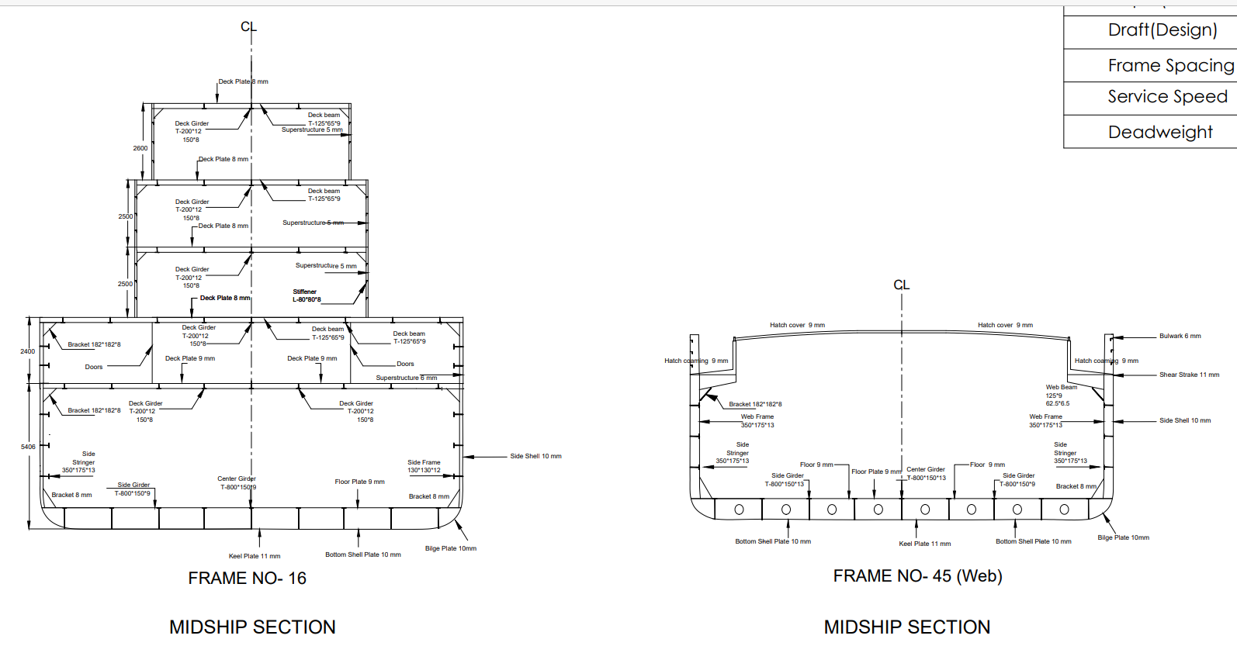
MIDSHIP SECTION

Slide 34
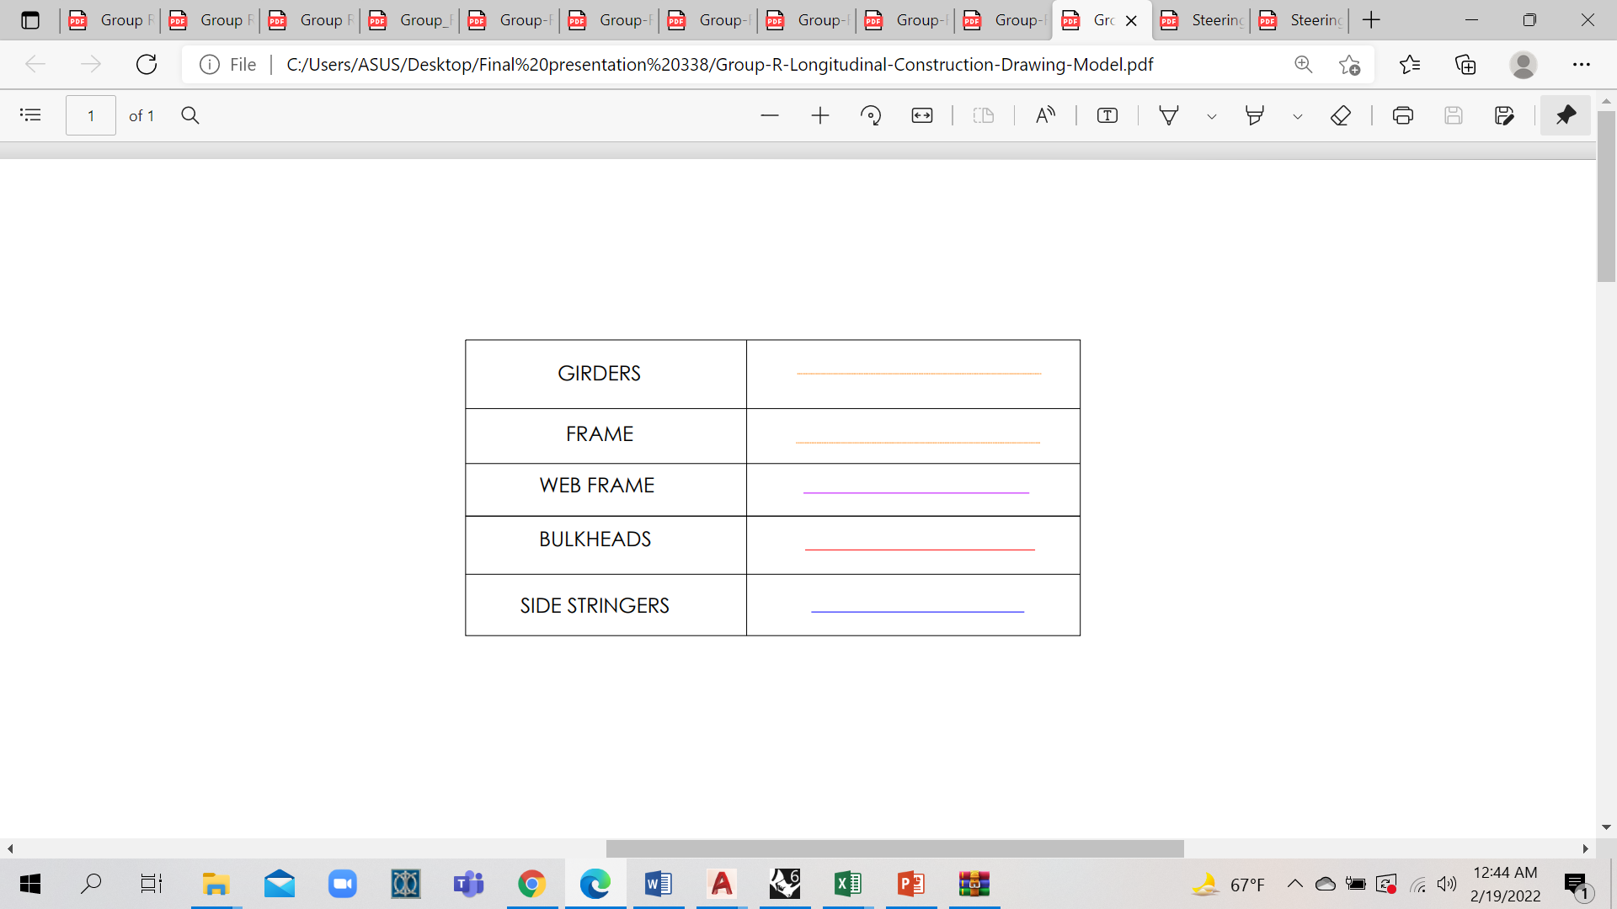
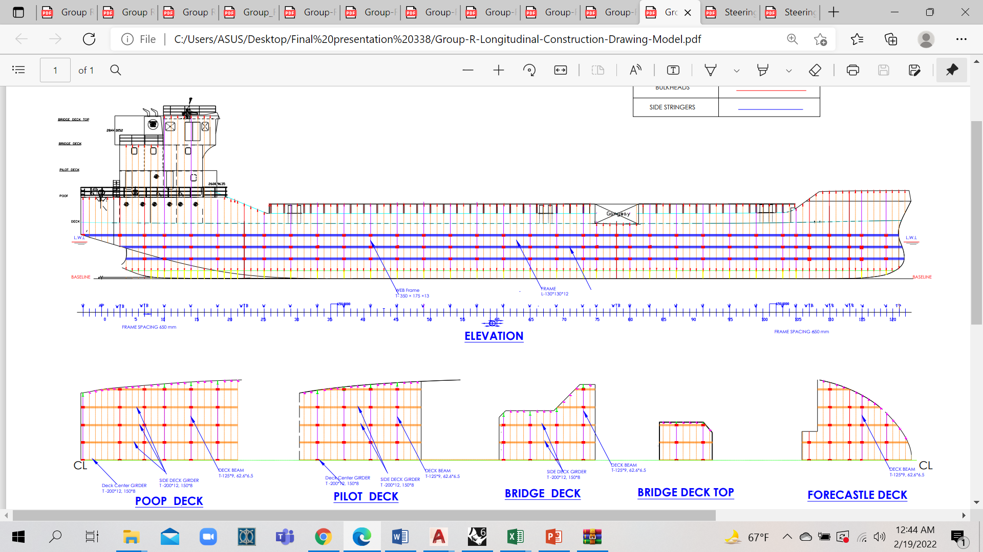
LONGITUDINAL CONSTRUCTION

Slide 35
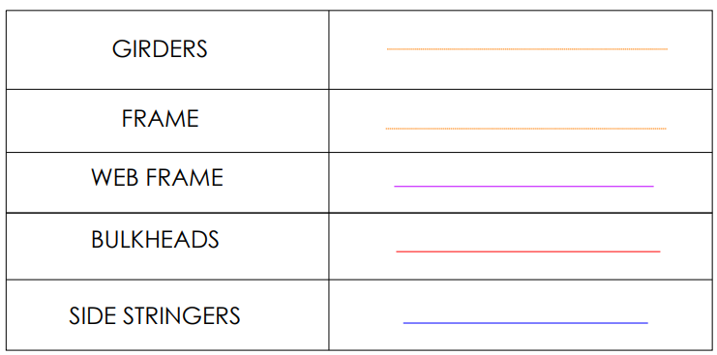
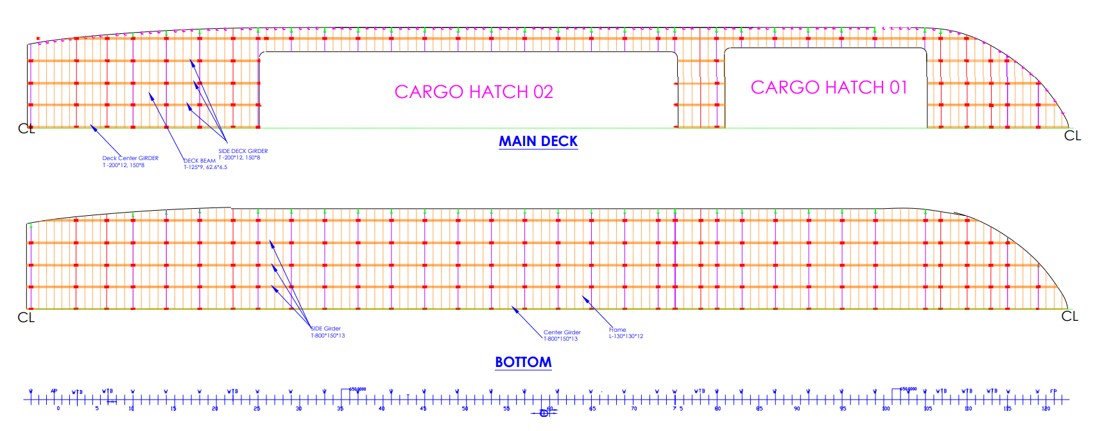
LONGITUDINAL CONSTRUCTION

Slide 36
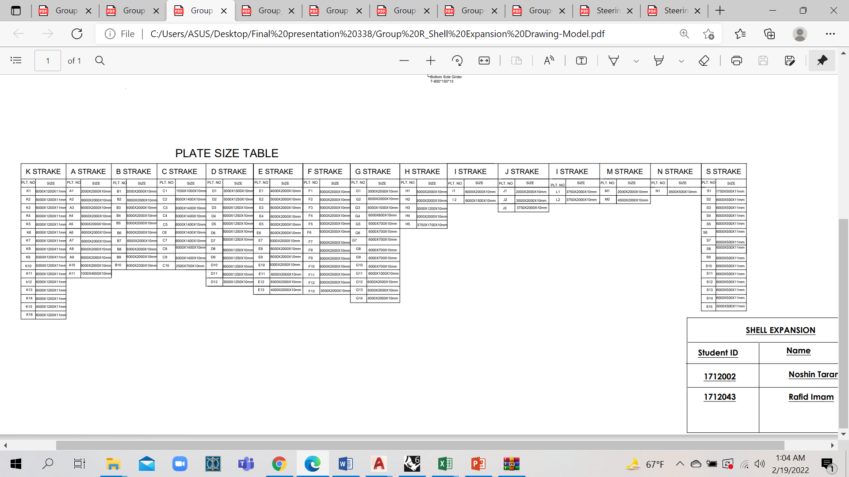
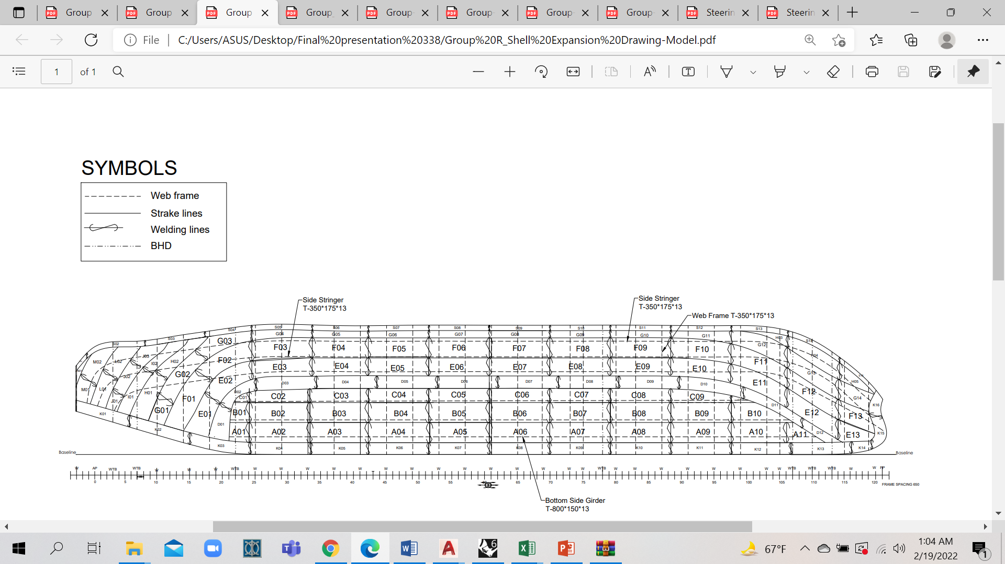
SHELL EXPANSION

Slide 37
RESISTANCE CALCULATION BY HOLTROP AND MENNEN’S METHOD
Speed of our Ship , V=5.14 ms⁻¹
Froude No=0.1845
Reynold’s No= 4.06×10⁸
Resistance Components
Frictional Resistance, R_{F} | 35.6 kN
Wave-Making Resistance, R_{W} | 10.5 kN
Appendage Resistance , R_{APP} | 1.64 kN
Model Ship Correlation Resistance , R_{A} | 11.7 kN
Air Resistance , R_{AA} | 12.1 kN
Total Resistance, R_{T} | 90 kN
Total Resistance Co-efficient, C_{T} | 4.32×10⁻³

Slide 38
POWER CALCULATION
Efficiencies and QPC Calculation
Taylor Wake Fraction , w_{T} = 0.26
Thrust Deduction Factor , t = 0.22
Hull Efficiency , n_{H} = 1.057
Relative Rotative Efficiency, n_{R} = 1.028
QPC, Open Water Efficiency and Propeller RPM
 | Method 1 ( B_{P}- Delta Chart) | Method 2 (K_{T} and K_{Q})
QPC | 0.475 | 0.478
Propeller Open Water Efficiency, n_{O} | 0.44 | 0.446
Propeller RPM | 325 | 329

Slide 39
POWER CALCULATION
Total resistance | R_{T} | R_{F}+ R_{APP} + R_{w} + R_{A} + R_{AA} | 90 | kN
Effective Power | P_{E} | R_{T}*V | 460.52 | kW
QPC |  |  | 0.47
Delivered Power | P_{D} |  | 969.66 | kW
Shaft Efficiency | n_{S} |  | 0.95
Shaft Power | P_{S} |  | 1020.69 | kW
 |  | Transmission line loss 5% for transmission via gear box
Engine power |  |  | 1074.41 | kW
Brake Power | P_{b} | (85% MCR),Considering 15% sea margin | 1200.81 | kW
Total installed power | P_{I} | (100% MCR) | 1412.72 | kW
 |  |  | 710*2 | kW

Slide 40
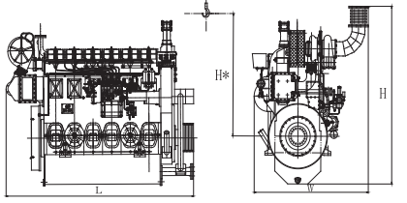
ENGINE SELECTION
We finally considered Two Engines of 710 kW or 950 HP
Engine Specifications
Model No: XCW6200ZC-1 (Ref. Marine Propulsion Engine , Weichai Catalogue)
Engine Power : 720 kW or 969 HP
Engine RPM : 1000
Net Weight : 6300 kg
Mechanical Pump Bore and stroke:200×270 mm
Displacement : 50.89 L
Min Fuel Consumption : 200g/kW-h
Dimension: L-2828 mm, W-1726 mm, H-2412mm, H*-2000 mm

Slide 41
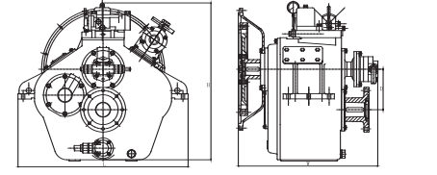
GEAR BOX SELECTION
Marine Gear Box Specifications
Model: WHG120 (Ref. Marine Propulsion Engine , Weichai Catalogue)
Input Speed: 750-2000 RPM
Gear Ratio : 3.03
Net Weight: 120 kg
Dimension : 792 mm× 609 mm× 736 mm

Slide 42
LACKINGS FROM THIRD PRESENTATION
Incomplete Rudder Design & Steering Arrangement
Incomplete Propeller Design
Incomplete Trim Calculation
Incomplete Stability Calculation
Incomplete Engine Foundation scantling, Design of Engine Foundation

Slide 43

ACHIEVEMENTS
Trim Calculation
Stability Calculation
Rudder Design and Steering Arrangement
Propeller Design & Shaft Arrangement
Design of Engine Foundation

Slide 44
RUDDER CALCULATION SUMMARY
ITEM | VALUES
Area of a Single Rudder | 2.98 m²
Rudder Force | 60.40 kN
Rudder Torque | 21.20 kN-m
Rudder Stock Diameter | 100 mm
Rudder Coupling Bolt Diameter | 25 mm
Rudder Coupling Flange Thickness | 25 mm
Rudder Pintle Thickness | 8 mm
Rudder Pintle Diameter | 55 mm
Rudder Plate Thickness | 8 mm
Rudder Web Plate Thickness | 7 mm
Rudder Horizontal Frame Spacing | 560 mm
Rudder Vertical Frame Spacing | 830 mm
Profile | NACA -0020

Slide 45
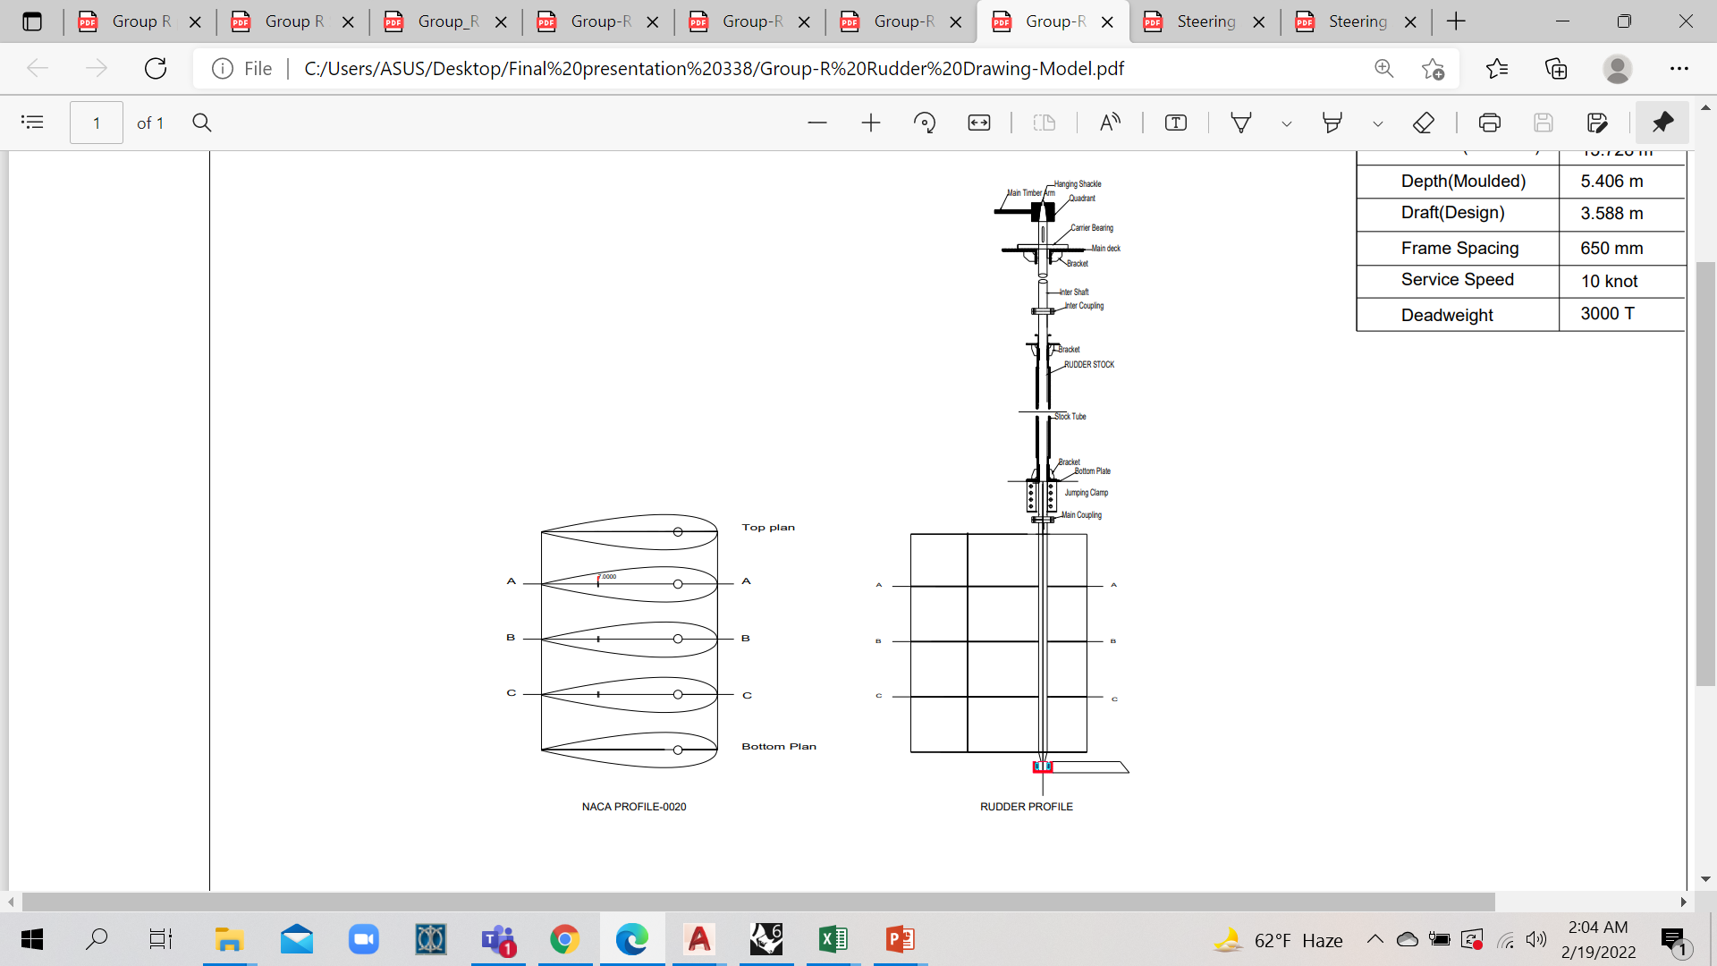
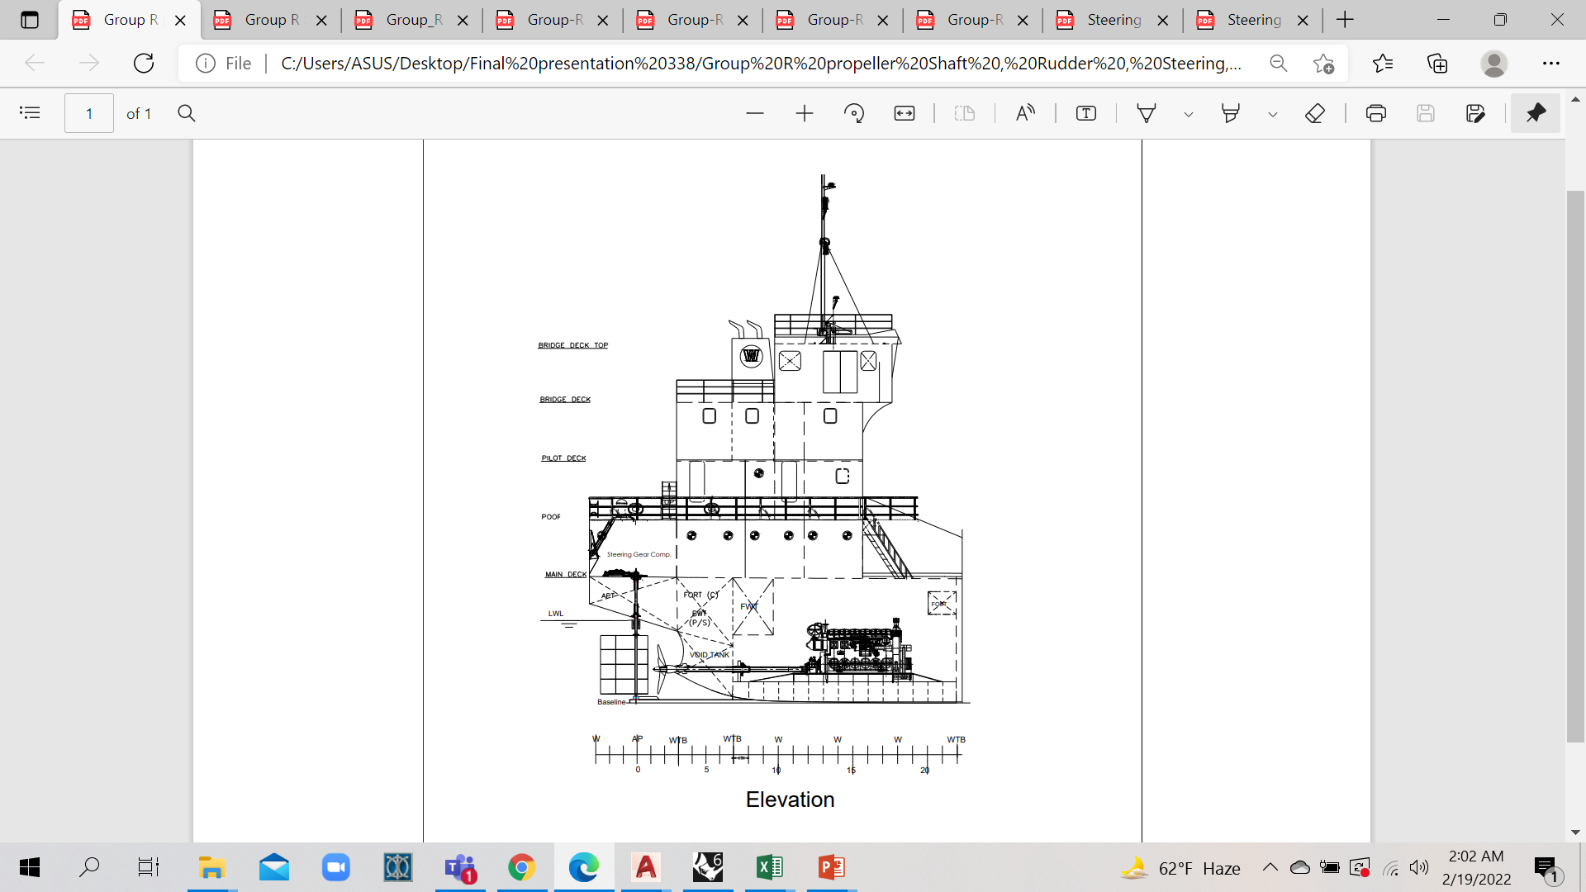
RUDDER DESIGN

Slide 46
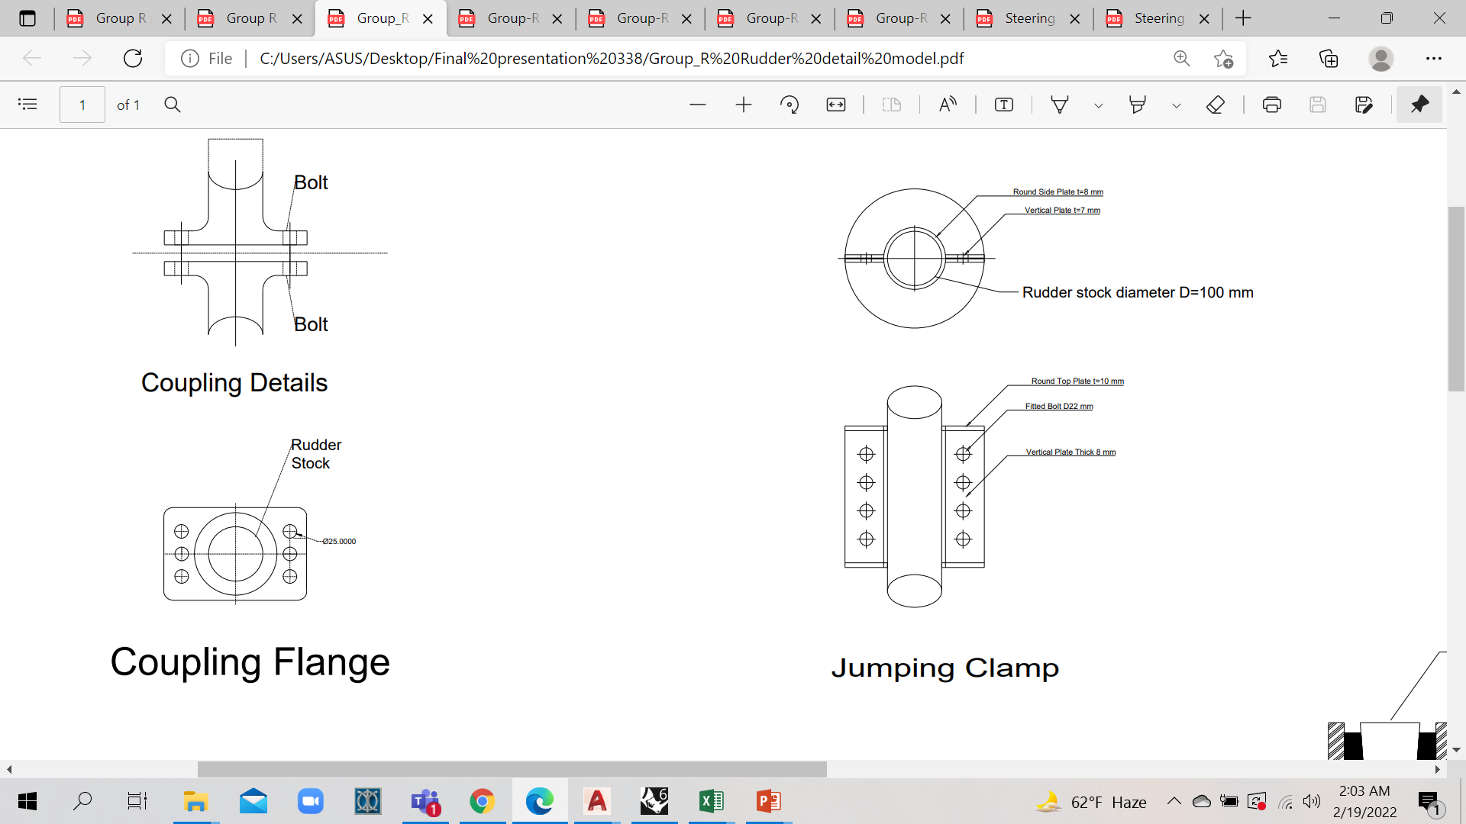
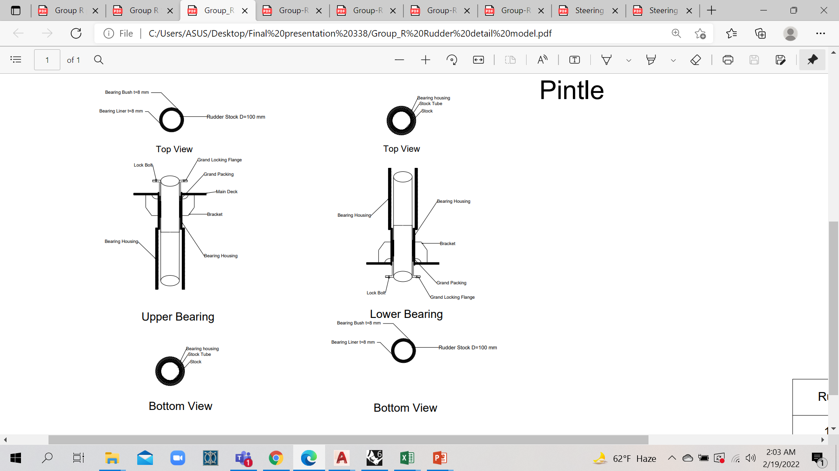
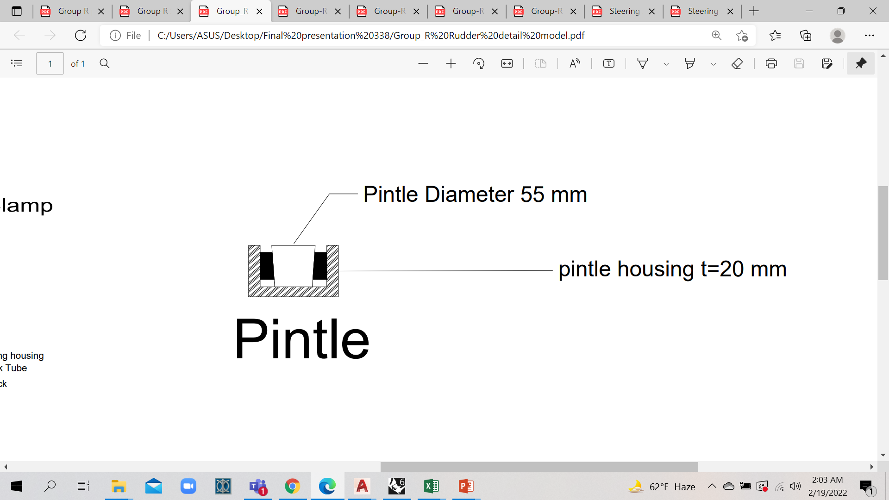
RUDDER DESIGN

Slide 47
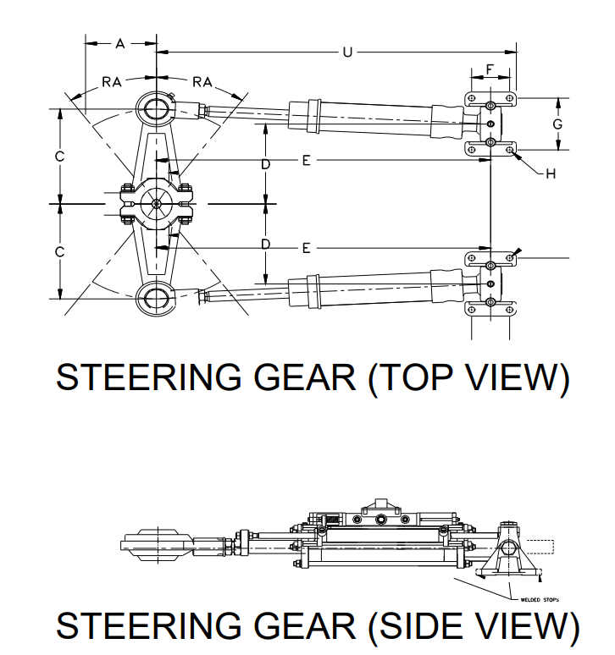
STEERING GEAR ARRANGEMENT
Working Torque for Steering Gear 25.5 kN-m
Steering Gear Model -7093- B20 ( Ref. Kobelt Electro-Hydraulic Steering Gear Catalogue)

Slide 48
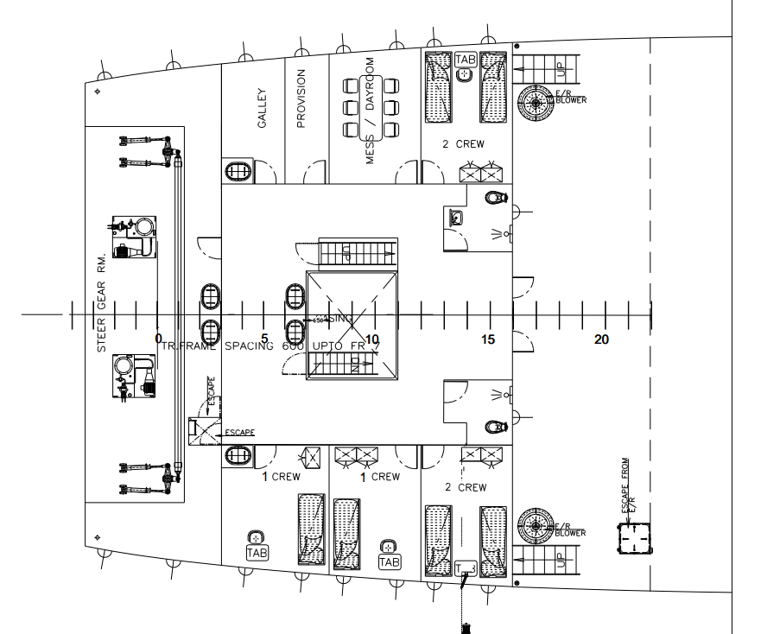
STEERING GEAR ARRANGEMENT
CL
Steering Arrangement (Plan View)

Slide 49
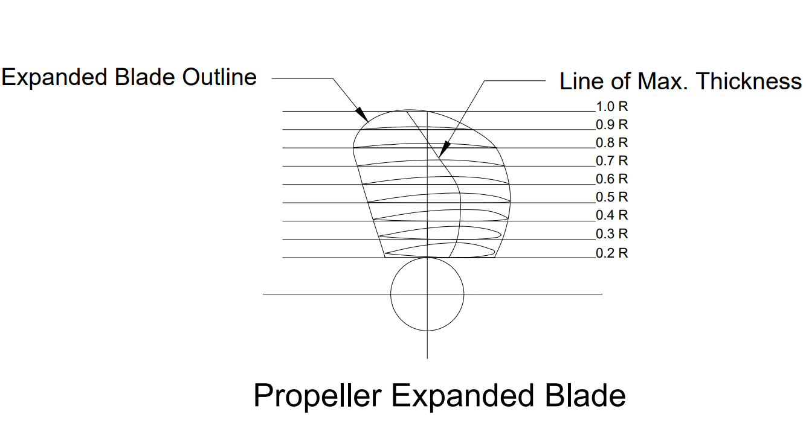
PROPELLER DESIGN
Propeller Diameter at Behind Condition: 2.09 m
Propeller Diameter at open water Condition: 2.15 m
Blade Area Ratio: 0.55
Number of Blades: 3
Pitch-Diameter Ratio: 0.64

Slide 50
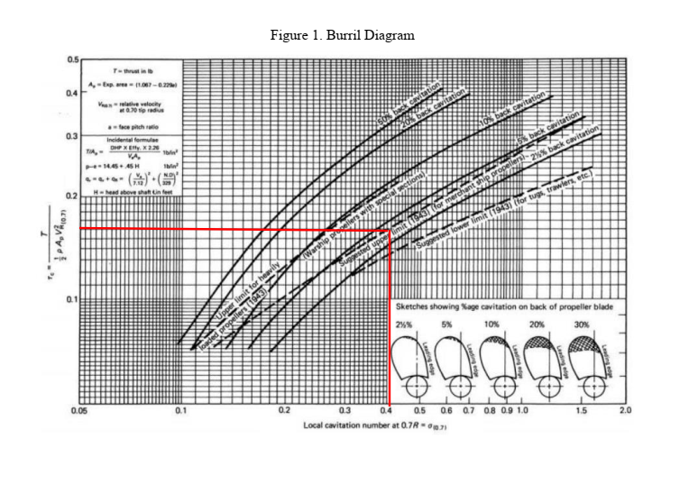
PROPELLER CAVITATION CHECK
Local Cavitation Number , σ_{0.7} = 0.41
Mean Thrust Loading Coefficient , τ_{c} = 0.16

Slide 51
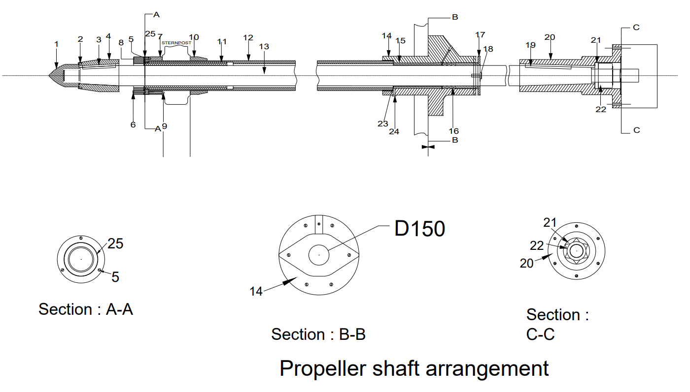
PROPELLER SHAFT ARRANGEMENT
Diameter of Propeller Shaft 150 mm
Shaft Arrangement

Slide 52
ENGINE FOUNDATION SCANTLING
ITEM | DIMENSION
Top Plate Area | 105.20 cm²
Top Plate Width | 450 mm
Top Plate Thickness | 25 mm
Girder Web Thickness | 12 mm
Floor Web Thickness | 9 mm
Floor Depth | 800 mm
Bracket Thickness | 7 mm
Foundation Bolt Diameter | 30 mm

Slide 53
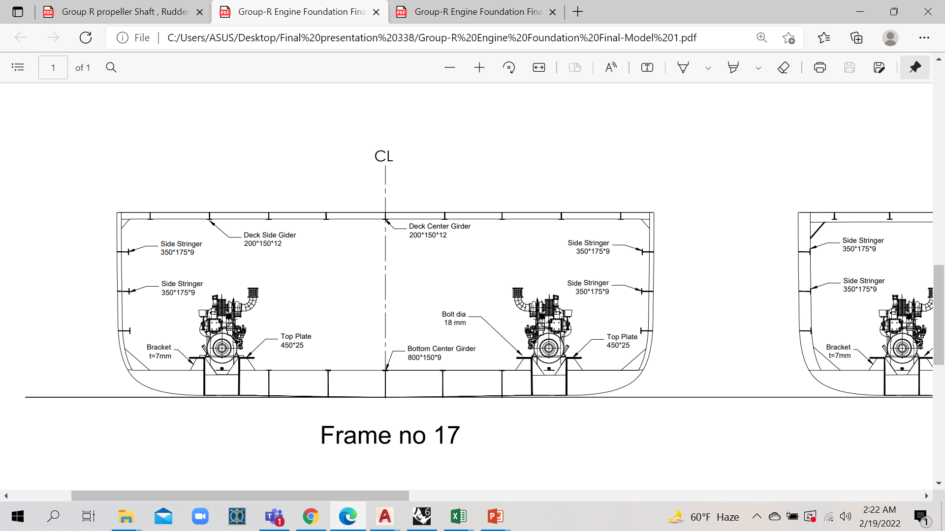
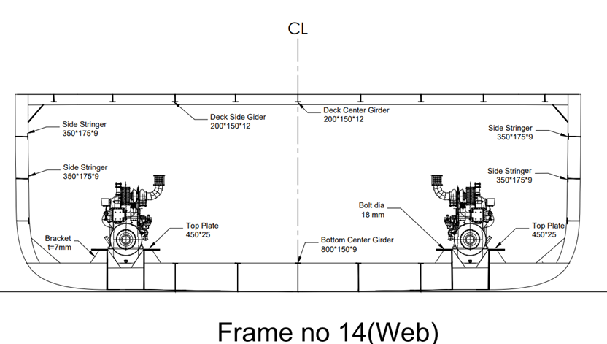
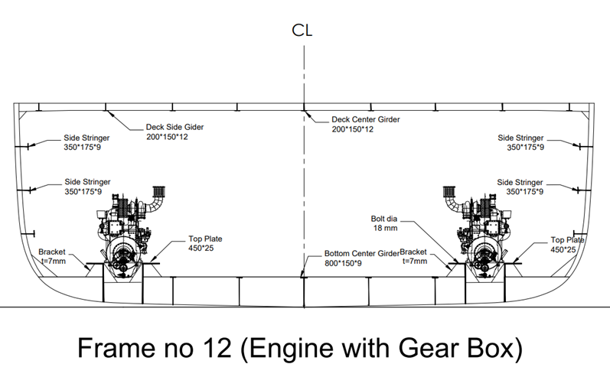
DESIGN OF ENGINE FOUNDATION

Slide 54
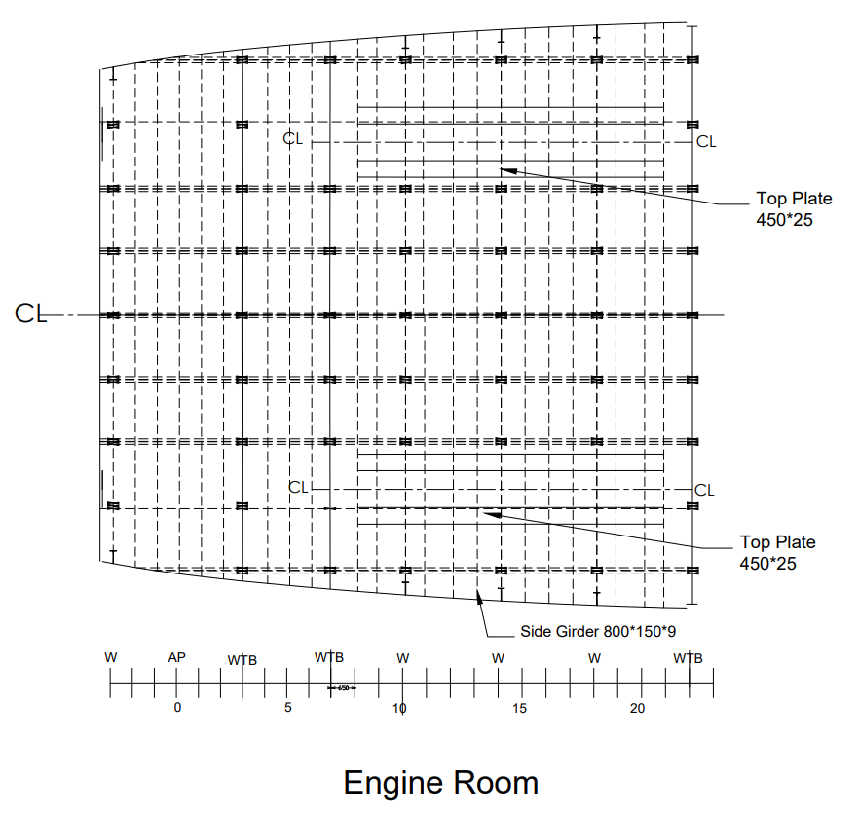
DESIGN OF ENGINE FOUNDATION

Slide 55
DETAILED LIGHTWEIGHT AND DEADWEIGHT CALCULATION
Total Weight of plates | 418.98 tonnes
Total weight of structural and stiffening members | 154.04 tonnes
Total Steel weight (considering 10% scrap) | 630.20 tonnes
Machinery weight | 45.61 tonnes
Wood and Outfit Weight | 12.60 tonnes
Lightweight | 688.55 tonnes

Slide 56
DETAILED LIGHTWEIGHT AND DEADWEIGHT CALCULATION
Capacity of the Cargo Holds | 2898.86 tonnes
Capacity of Fresh Water Tank | 15.00 tonnes
Capacity of Fuel Oil Reserve Tank | 9.77 tonnes
Capacity of Lubricating Oil Reserve Tank | 0.06 tonnes
Capacity of Backward Ballast Water Tank | 160.19 tonnes
Crew weight | 1.12 tonnes
Provision | 0.80 tonnes
Deadweight | 3087.21 tonnes

Slide 57
DETAILED LIGHTWEIGHT AND DEADWEIGHT CALCULATION
Lightweight | 688.55 tonnes
Deadweight | 3087.21 tonnes
Displacement | 3776.00 tonnes
Preliminary calculated deadweight was 3000 tonnes
Preliminary calculated displacement was 4243.90 tonnes

Slide 58
TRIM CALCULATION AT FULL LOADED DEPARTURE CONDITION
LCG 0.40 m fwd from midship
LCB 1.45 fwd of Midship
LCF -.55 Fwd
MCTC 63.53
Displacement 3776 tonnes
Change in trim -62.75 cm
Change in draught at aft perpendicular -30.93 cm
Change in draught at fore perpendicular -31.82 cm
Final draft fwd. | 3.27 m
Final draft aft | 3.89 m
Trim by Stern

Slide 59
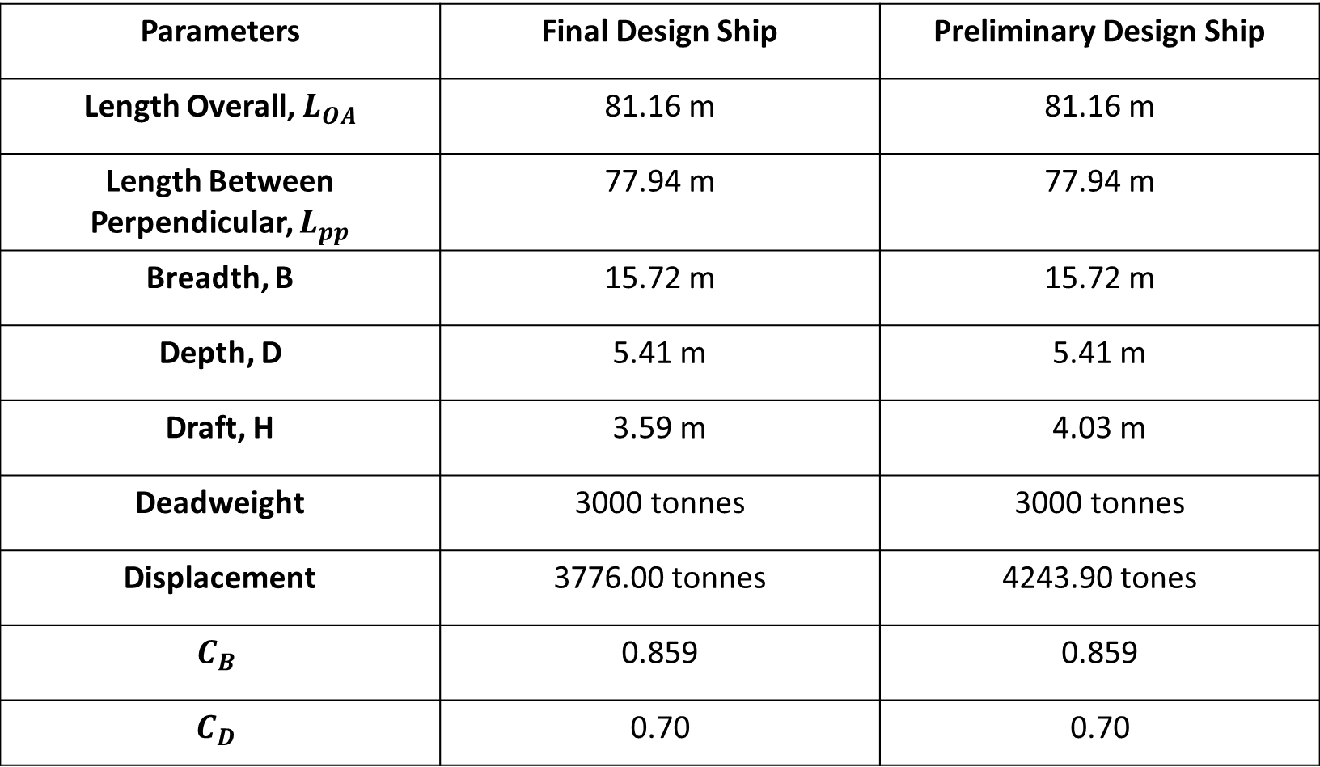
Principal Particulars Comparison between Preliminary and Final Design Ship
Parameters | Final Design Ship | Preliminary Design Ship
Length Overall, $L_{OA}$ | 81.16 m | 81.16 m
Length Between Perpendicular, $L_{pp}$ | 77.94 m | 77.94 m
Breadth, B | 15.72 m | 15.72 m
Depth, D | 5.41 m | 5.41 m
Draft, H | 3.59 m | 4.03 m
Deadweight | 3000 tonnes | 3000 tonnes
Displacement | 3776.00 tonnes | 4243.90 tones
$$C_{B}$$ | 0.859 | 0.859
$$C_{D}$$ | 0.70 | 0.70

Slide 60
Properties | IMO value | Lightship Condition
Area up to 30 degree (m-rad) | ≥ 0.055 | 1.405
Area up to 40˚ (m-rad) | ≥ 0.09 | 2.160
Area up to 30˚ - 40˚ (m-rad) | ≥ 0.03 | 0.755
GZ at 30 degree (m) | ≥ 0.2 | 4.901
Max. GZ at (degree) | ≥ 30 (preferable) but not ≤ 25 | 47.000
Initial Metacentric Height (m) | Should not be ≤ 0.15 | 10.800
STABILITY IN LIGHTSHIP CONDITION
PASS
PASS
PASS
PASS
PASS
PASS
Lightship Condition
 | Capacity (tonnes) | vcg(from keel) (m) | Vcg moment (tonnes-m)
Cargo Hold1 | 0.00 | 3.09 | 0.00
Cargo Hold2 | 0.00 | 3.09 | 0.00
Lightweight | 688.97 | 3.66 | 2518.75
FWT(both) | 0.00 | 4.10 | 0.00
FORT | 0.00 | 3.90 | 0.00
LORT | 0.00 | 3.90 | 0.00
FOST*2 | 0.00 | 3.90 | 0.00
B.BWT | 0.00 | 2.80 | 0.00
Total Capacity | 688.97 | VCG | 3.66 m

Slide 61
Properties | IMO value
Area up to 30 degree (m-rad) | ≥ 0.055
Area up to 40˚ (m-rad) | ≥ 0.09
Area up to 30˚ - 40˚ (m-rad) | ≥ 0.03
GZ at 30 degree (m) | ≥ 0.2
Max. GZ at (degree) | ≥ 30 (preferable) but not ≤ 25
Initial Metacentric Height (m) | Should not be ≤ 0.15
Fully Loaded Condition
0.609 | PASS
0.925 | PASS
0.316 | PASS
2.179 | PASS
42.000 | PASS
4.500 | PASS
STABILITY IN FULLY LOADED DEPARTURE CONDITION
Fully Loaded Departure Condition
 | Capacity (tonnes) | vcg(from keel) (m) | Vcg moment (tonnes-m)
Cargo Hold1 | 937.60 | 3.09 | 2897.18
Cargo Hold2 | 1965.26 | 3.09 | 6072.67
Lightweight | 688.55 | 3.72 | 2562.93
FWT(both) | 11.25 | 4.10 | 46.13
FORT | 9.77 | 3.90 | 38.12
LORT | 0.07 | 3.90 | 2.56
FOST*2 | 1.93 | 3.90 | 7.52
B.BWT | 160.19 | 2.80 | 448.54
Total Capacity | 3774.62 | VCG | 3.20 m

Slide 62
Properties | IMO value | Ballast in Departure Condition
Area up to 30 degree (m-rad) | ≥ 0.055 | 1.1958 | PASS
Area up to 40˚ (m-rad) | ≥ 0.09 | 5.3890 | PASS
Area up to 30˚ - 40˚ (m-rad) | ≥ 0.03 | 4.1932 | PASS
GZ at 30 degree (m) | ≥ 0.2 | 3.9968 | PASS
Max. GZ at (degree) | ≥ 30 (preferable) but not ≤ 25 | 44 | PASS
Initial Metacentric Height (m) | Should not be ≤ 0.15 | 9.2 | PASS
STABILITY IN BALLAST IN DEPARTURE CONDITION
In Ballast in Departure Condition
 | Capacity (tonnes) | vcg(from keel) (m) | Vcg moment (tonnes-m)
Cargo Hold1 | 0.00 | 3.09 | 0.00
Cargo Hold2 | 0.00 | 3.09 | 0.00
Lightweight | 688.97 | 3.66 | 2518.75
FWT(both) | 15.00 | 4.10 | 46.13
FORT | 9.77 | 3.90 | 38.12
LORT | 0.07 | 3.90 | 2.56
FOST*2 | 1.93 | 3.90 | 7.52
B.BWT | 135.19 | 2.80 | 448.54
FPT | 191.44 | 3.28 | 627.91
FBWT | 190.74 | 2.75 | 524.54
BBWT | 81.35 | 4.23 | 344.11
DBT1 | 285.62 | 0.44 | 125.67
DBT2 | 563.36 | 0.44 | 247.88
APT | 130.06 | 4.76 | 619.09
Total Capacity | 2293.50 | VCG | 2.42 m

Slide 63
THANK YOU

